Slide 1
Trade, Logistics and Freight Distribution
CHAPTER 7

Slide 2
Usage Conditions
DO NOT COPY, TRANSLATE OR REDISTRIBUTE THIS DOCUMENT.
The contents of this document can be freely used for personal or classroom use ONLY.
Although the material contained in this document is freely available, it is not public domain. Its contents, in whole or in part (including graphics and datasets), cannot be copied and published in ANY form (printed or electronic) without consent.
If you have accessed this document through a third party (such as a content farm), keep in mind that this party is illegally redistributing this content. Please refer to the true source (https://transportgeography.org/) instead of the third party.
Permission to use any graphic material herein in any form of publication, such as an article, a book or a conference presentation, on any media must be requested prior to use.
Information cited from this document should be referred as: Rodrigue, J-P et al. (2020) The Geography of Transport Systems, Hofstra University, Department of Global Studies & Geography, https://transportgeography.org/.

Slide 3
Table of Contents
Transborder Transportation
Globalization and International Trade
Freight Transportation and Value Chains
Logistics and Freight Distribution

Slide 4
Transborder Transportation

Slide 5
International Trade, Transportation Chains and Flows
International Trade
Origin
Destination
A
B
Custom Procedures
Transport Chain
Decomposition
Rail
Maritime
Road
A
B
Composition
Transshipment
Customs
Physical Flows
Port
Distribution Center
A
B
Rail Yard
Transshipment Hub
Notes:
Source: Rodrigue, J-P (2012) "Supply Chain Management, Logistics Changes and the Concept of Friction", in P.V. Hall and M. Hesse (eds) Cities, Regions and Flows, London: Routledge. ISBN 978-0-415-68219-0.

Slide 6
Modal Shares of World Trade by Volume and Value, 2008
Notes:
Source: IHS Global Insight, Inc., World Trade Service. Does not include intra-EU trade.

Slide 7
Modal Shares of China Trade with Europe by Volume and Value, 2016
Notes:
Source: IHS Global Insight, Inc., World Trade Service. Does not include intra-EU trade.

Slide 8
Geostrategy of International Transportation
Perspective | Issues
Conquest | Acquire and conquer oceans, territories and resources. Maritime and railroad technology.
Competition | Mean to compete on the global economy. Prevalent force in shaping modern transportation systems. Right to carry national passengers and freight.
Jurisdiction | Subject to national rules and regulations. Territorial sea (22 km); complete jurisdiction. Exclusive Economic Zone (340 km); access to resources.
Cooperation | Common interests favor agreements. Involving access to infrastructures or setting standards (river navigation, rail gauge, trade agreements, transborder transportation).
Control | Controlling strategic locations. Reduce vulnerability to disruptions.

Slide 9
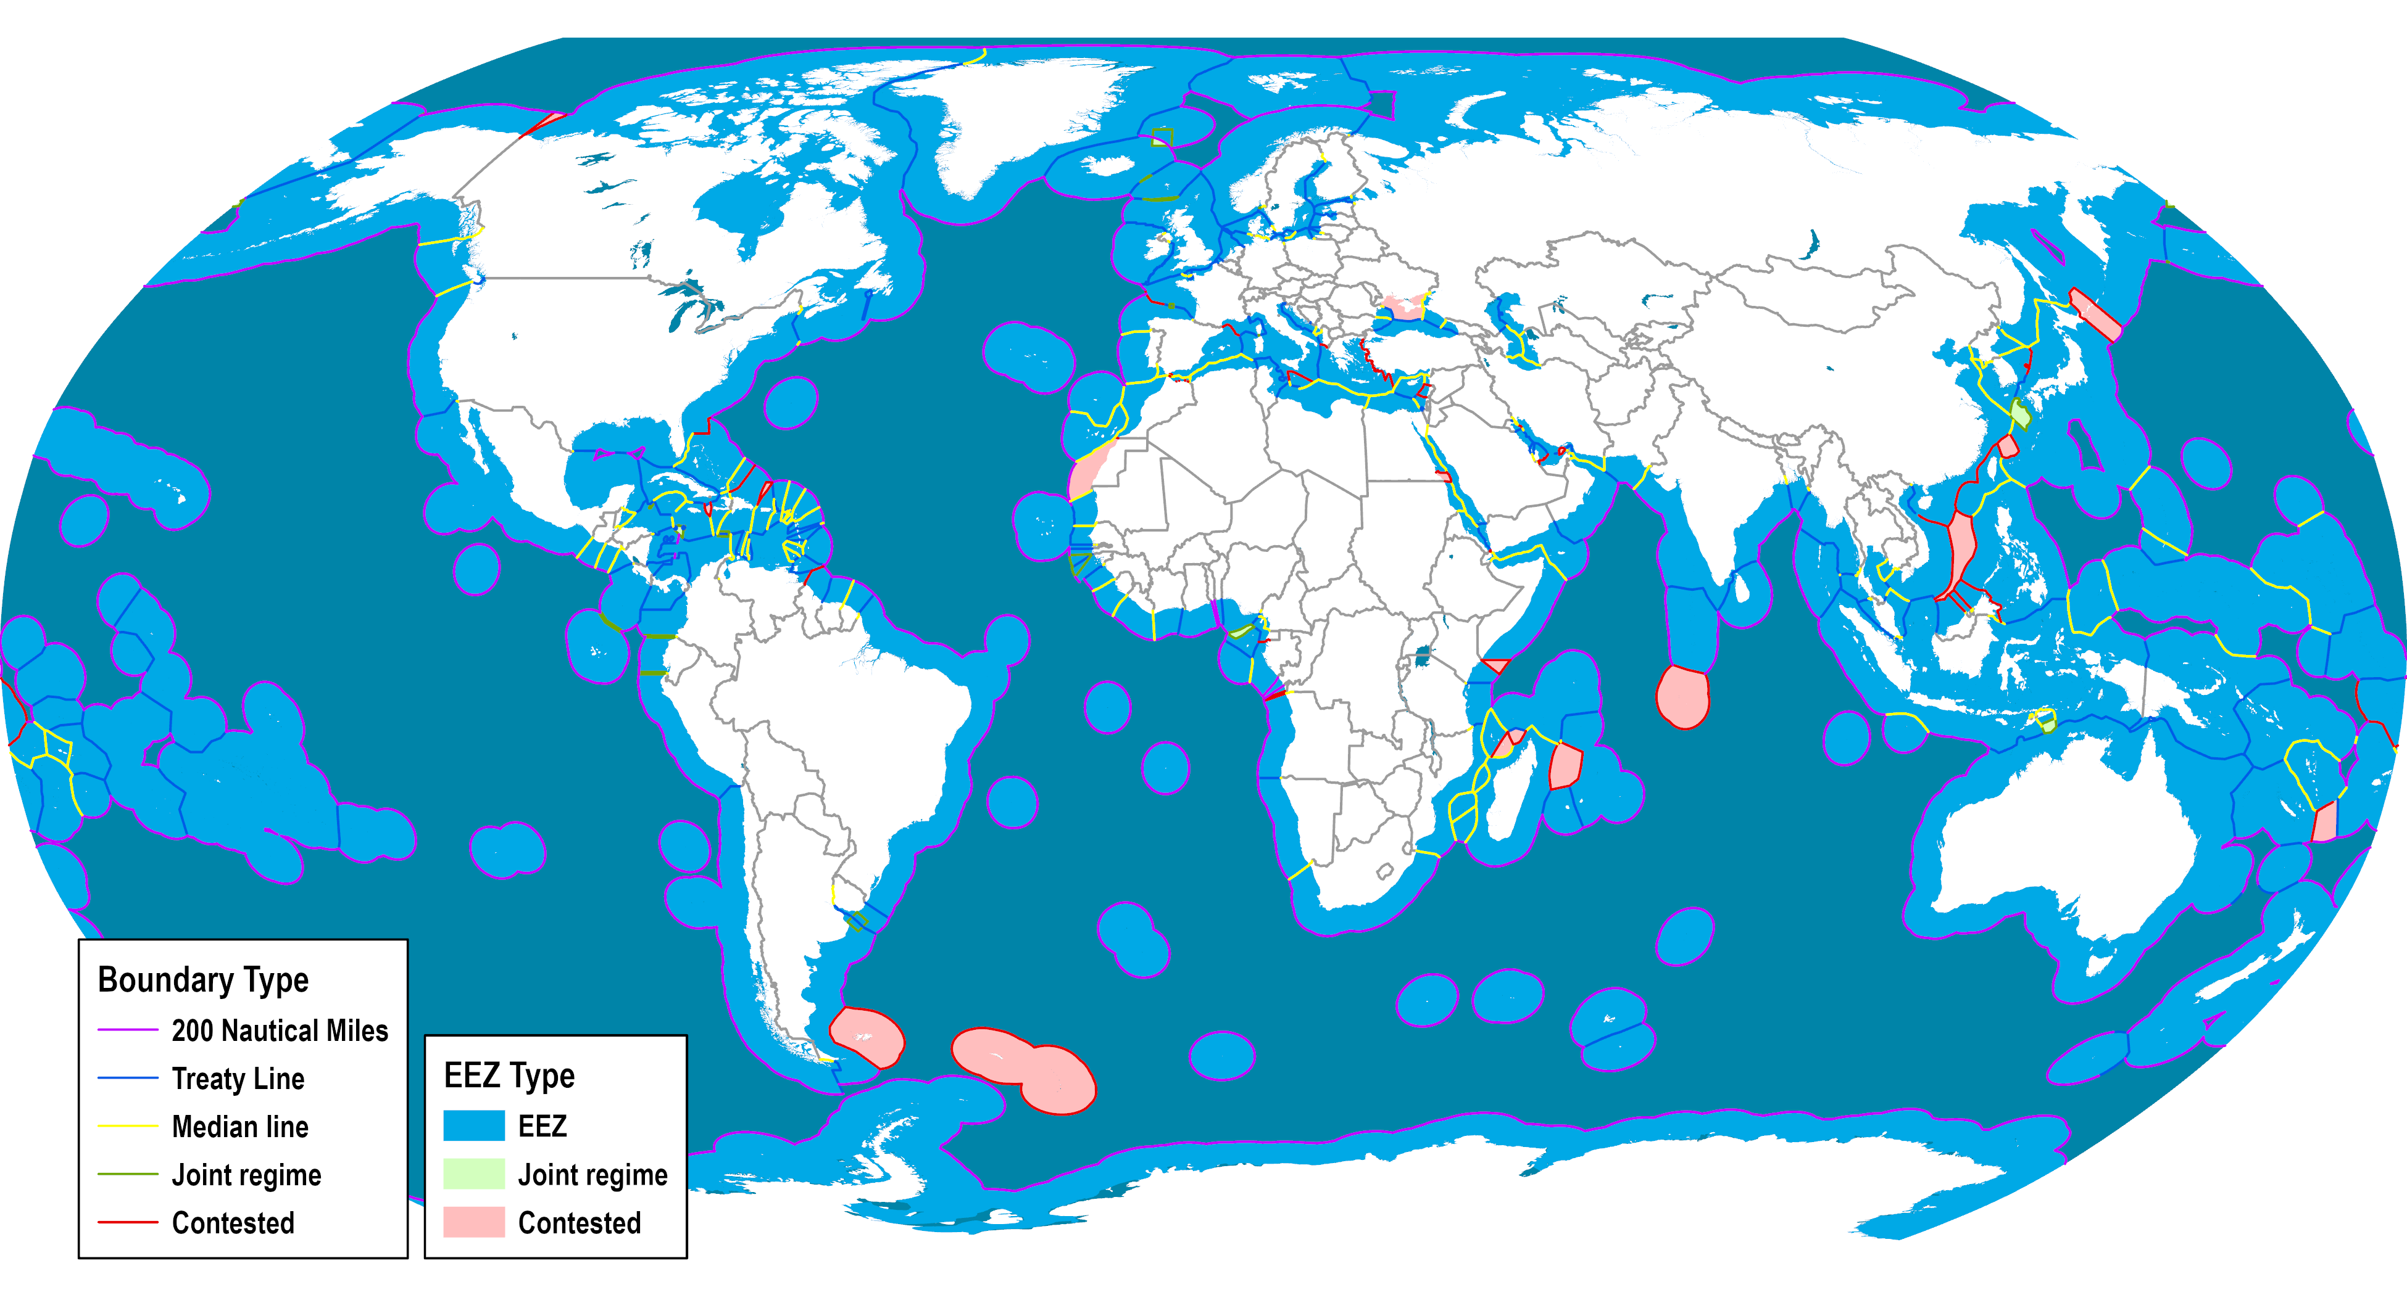
Exclusive Economic Zones
Notes:
Source: Flanders Marine Institute (2018). Maritime Boundaries Geodatabase: Maritime Boundaries and Exclusive Economic Zones (200NM), version 10. Available online at http://www.marineregions.org/ https://doi.org/10.14284/312
Map location: Strategic Maritime Passages

Slide 10
Levels of Economic Integration
High
Political
Union
Common government
Economic
Union
No barriers for internal trade, free movement of labor, harmonized tax rates, common monetary and fiscal policy: EU (partial)
Common
Market
Free movement of capital and services. Different national regulations.
Level of integration
Customs
Union
Common external tariffs.
Free
Trade
Reduction of tariffs between members: NAFTA, Mercosur, ASEAN (partial)
Low
Low
Complexity
High

Slide 11
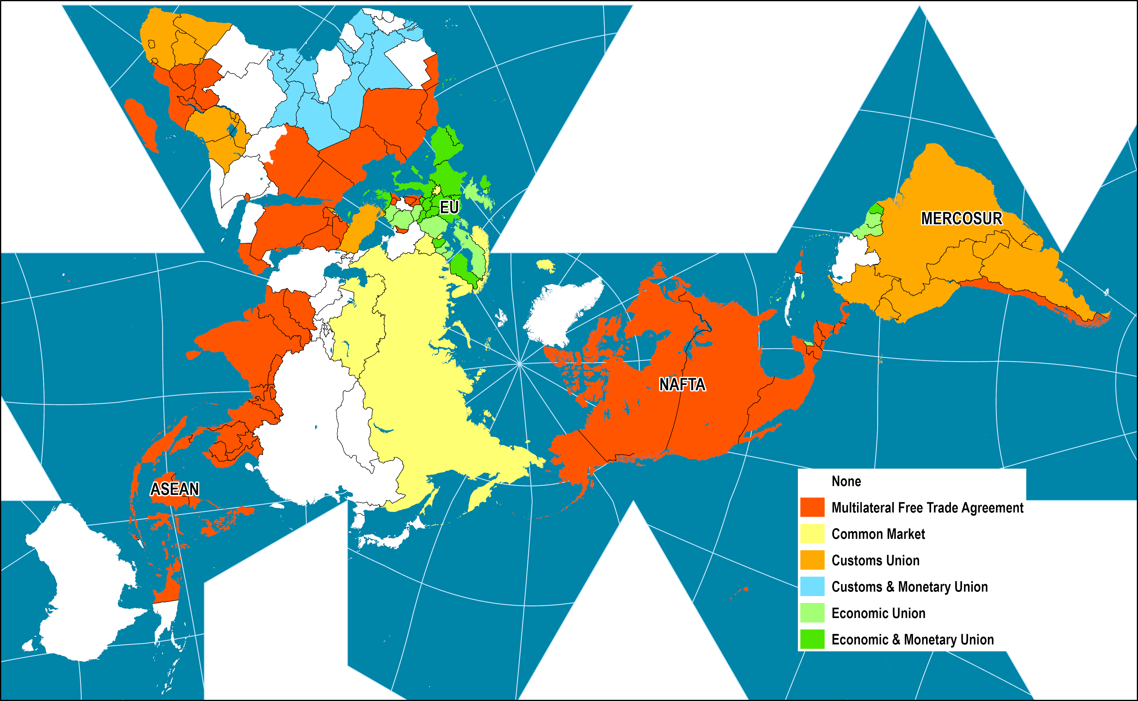
Economic Integration Levels, 2015
Notes:
Map location: global_socioeconomic

Slide 12
Number of Regional Trade Agreements on Customs and other Trade Facilitation Measures, 1995-2016
Notes:
Source: UNCTAD secretariat, based on WTO database on regional trade agreements
(http://rtais.wto.org/UI/PublicMaintainRTAHome.aspx).

Slide 13
Oil Transited at Major Strategic Locations, 2016
Notes:
Source: Energy Information Administration, World Oil Transit Chokepoints. http://www.eia.gov/todayinenergy/detail.cfm?id=330

Slide 14
Types of International Boundaries
Country A
Country A
Country A
Country A
Country B
Country B
Country B
Antecedent
Subsequent
Superimposed
Relic
Pre-existing; commonly corresponds to a physical feature.
Rivers, Bays, Lakes, Mountains.
Set after the settlements of different groups meet.
Often correspond to their respective ecumene.
Boundary is imposed by an outside force (treaty).
May not reflect existing cultural landscape.
No longer a boundary.
Often the outcome of political changes.
Still a visible imprint on the landscape.

Slide 15
The Effect of a Border on a Transportation Network
Border crossing
Border

Slide 16
The Effect of a Border on Freight Distribution
Barrier
Operational Costs
Gateway

Slide 17
Modal Shares of U.S.-NAFTA Merchandise Trade by Value and Weight, 2013
Notes:
Source: Bureau of Transport Statistics, North American Trade and Travel Trends.

Slide 18
Types of Free Zones
Type | Function | Location | Markets
Free Port | Trade and logistics platform | Port cities or connected locations | Domestic, internal and export markets
Free Trade Zone | Trade support with entrepots and trade-related activities. | Ports of entry | Domestic and re-exports
Export Processing Zone | Develop manufacturing and processing | Varied, usually close to a major transport node | Exports and domestic
Special Economic Zone | Attract foreign direct investments | Commercial gateways | Exports and re-exports
Notes:
Source: adapted from World Bank (2008) Special Economic Zones: Performance, Lessons Learned, and Implications for Zone Development, Washington, DC: The World Bank.

Slide 19
Types of Free Zones
Free Port
Free Trade Zone
Export Processing Zone
Special Economic Zone
International
Domestic
International
Domestic
International
Domestic
International
Trade and logistics platform
Trade support with entrepots and trade-related activities
Develop manufacturing and processing
Attract foreign direct investments
Port cities or connected locations
Ports of entry
Usually close to a major transport node
Commercial gateways
Domestic, internal and export markets
Domestic and re-exports
Exports and domestic
Exports and re-exports

Slide 20
Specialized Free Zones
Type | Function | Location | Markets
Technology or Science Parks | Promote technology and scientific industries | Adjacent to universities and research institutes | Domestic and export
Energy Zones | Promote energy industries | Petrochemical hubs or energy sources | Domestic and export
Financial Services | Development of off-shore financial services | Varied | Export
Software and Internet | Development of information technologies | Adjacent to universities, urban areas | Export
Airport-based | Air cargo trade and handling | Connected airports | Re-export and domestic
Tourism | Integrated tourism development | Touristic amenities | Export and domestic
Logistics Parks | Support warehousing and transshipment | Near transport hubs | Re-export
Notes:
Source: adapted from World Bank (2008) Special Economic Zones: Performance, Lessons Learned, and Implications for Zone Development, Washington, DC: The World Bank.

Slide 21
Globalization and International Trade

Slide 22



The Flows of Globalization
Trade
Migration
Telecommunications
Flows of physical goods (mainly asymmetrical)
Flows of people (mainly symmetrical)
Flows of information (mainly asymmetrical)
Raw materials, energy, food, parts and consumption goods
Permanent, temporary (migrant workers), tourism, business transactions
Communication, power exchanges, symbolic exchanges
Telecommunication systems (postal, internet, telephone, radio)
Freight transport modes (maritime, rail, trucking)
Passengers transport modes (vehicles, air, rail)
Interconnected hub-and-spoke networks
Interconnected hub-and-spoke networks
Interconnected and redundant hub-and-spoke networks
Ports as main hubs
Airports as main hubs
Global cities as main hubs

Slide 23
The Flows of Globalization
 | Trade | Migration | Telecommunication
Nature | Flows of physical goods | Flows of people | Flows of information
Types | Raw materials, energy, food, parts and consumption goods | Permanent, temporary (migrant workers), tourism, business transactions | Communication, power exchanges, symbolic exchanges
Medium | Transport modes and terminals (freight) | Transport modes and terminals (passengers) | Transport modes and terminals (postal), telecommunication systems
Network | Hub and spoke with interconnections | Hub and spoke | Redundant and diffuse (point to point)
Main Gateways | Ports | Airports | Global cities
Speed | Low to average | Slow to fast | Instantaneous
Capacity | Very large | Large | Almost unlimited

Slide 24
Economic Rationale of Trade
Country 1
Country 2
Country 1
Country 2
Country 3
Country 4
Country 3
Country 4
Without Trade
With Trade
Small national markets.
Limited economies of scale.
High prices and near monopoly.
Limited product diversity.
Different standards.
Increased competition.
Economies of scale.
Specialization.
Lower prices.
Interdependencies.

Slide 25
Absolute and Comparative Advantages
Country A: 100 resource units. 10 units for 1 unit of steel. 4 units to produce 1 unit of textiles.
Country B: 100 resource units. 5 units for 1 unit of steel. 20 units to produce 1 unit of textiles.
Country A: 100 resource units. 10 units for 1 unit of steel. 10 units to produce 1 unit of textiles.
Country B: 100 resource units. 4 units for 1 unit of steel. 5 units to produce 1 unit of textiles.
Steel output without trade (1): 5+10 = 15
Textiles output without trade (1): 2.5+12.5 = 15
Steel output with trade (2): 0+20 = 20
Textiles output with trade (2): 25+0 = 25
Steel output without trade (1): 5+12.15 = 17.5
Textiles output without trade (1): 5+10 = 15
Steel output with trade (2): 0+17.5 = 17.5
Textiles output with trade (2): 10+6 = 16

Slide 26
Composition of British Trade, 1910s and 1990s
Notes:
Source: Adapted from Baldwin, R. and Martin, P. (1999), “Two waves of globalization: Superficial similarities, fundamental differences,” National Bureau of Economic Research, Working Paper #6904.

Slide 27
Favorable and Contentious Factors in International Trade
Factor Substitution
Comparative Advantages
Openness
Interdependencies
Specialization promotes national productivity.
Increases the quantity of goods and lowers their cost.
Lower prices for consumers because of lower tariff and non-tariff barriers.
Promotes collaboration, standards and technology exchanges.
Labor and capital cannot be easily reconverted.
Some nations have limited advantages and resources.
May impact national industries and employment.
Protectionism.
Dependency on foreign goods and resources. Vulnerability to disruptions.

Slide 28
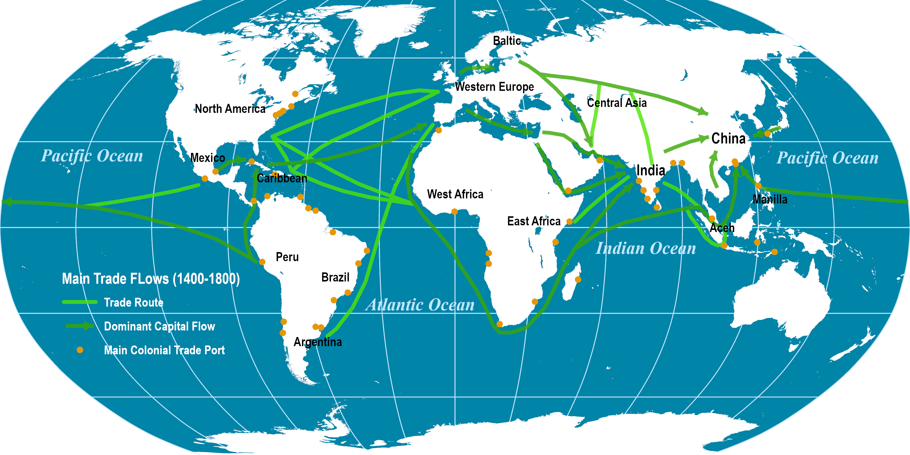
Major Global Trade Routes, 1400-1800
Notes:
Map location: colonial_history

Slide 29
Standard International Trade Classification (SITC)
SITC Class | Category | Examples
0 | Food & Live Animals | Meat (01), Fish (03), Wheat (041), Rice (042), Corn (044), Orange juice (0591), Sugar (0611), Coffee (071), Cocoa (072), Tea (0741)
1 | Beverages & Tobacco | Wine (1121), Beer (1123), Tobacco (12)
2 | Raw Materials | Rubber (23), Cotton (263), Iron ore (281)
3 | Fuels & Lubricants | Coal (32), Crude oil (333), Kerosene (3342), Natural gas (343)
4 | Animal & Vegetable Oils | Olive oil (4214), Corn oil (4216)
5 | Chemicals | Salt (52332), Fertilizers (56), Plastics (57)
6 | Manufactured Goods | Paper (64), Textiles (65), Cement (661), Iron & Steel (67), Copper (682)
7 | Machinery & Transport Equipment | Computer equipment (752), Televisions (761), Cars (781)
8 | Miscellaneous Manufactures | Furniture (82), Clothes (84), Footwear (85), Cameras (88111), Books (8921), Toys (894)
9 | Others | Postal packets (91)
Notes:
Source: http://www.intracen.org/tradstat/sitc3list.htm

Slide 30
Changes in the Global Trade Environment
Before 1970s
Immobile Factors of Production
Bulk point-to-point
Cope with scarcity
Country A
Country B
1970s – 1990s
Mobility of Factors of Production
Container shipping
Promote economic efficiency
1990s onward
Global Value Chains
Supply chain
Added value within commodity chains
Commodity Market
Global Market

Slide 31

Economic Integration and Interdependencies
Independent Nations
Interdependent Groups of Nations
Interdependency
H
A
H
A
(Low)
G1
B
(High)
B
G
G
C
F
D
F
D
C
E
E
G2

Slide 32
World Merchandise Trade, 1960-2019
Notes:
Source: WTO and World Bank. Current USD.
Merchandise Exports : http://data.worldbank.org/indicator/TX.VAL.MRCH.CD.WT
GDP: http://data.worldbank.org/indicator/NY.GDP.MKTP.CD?locations=1W

Slide 33
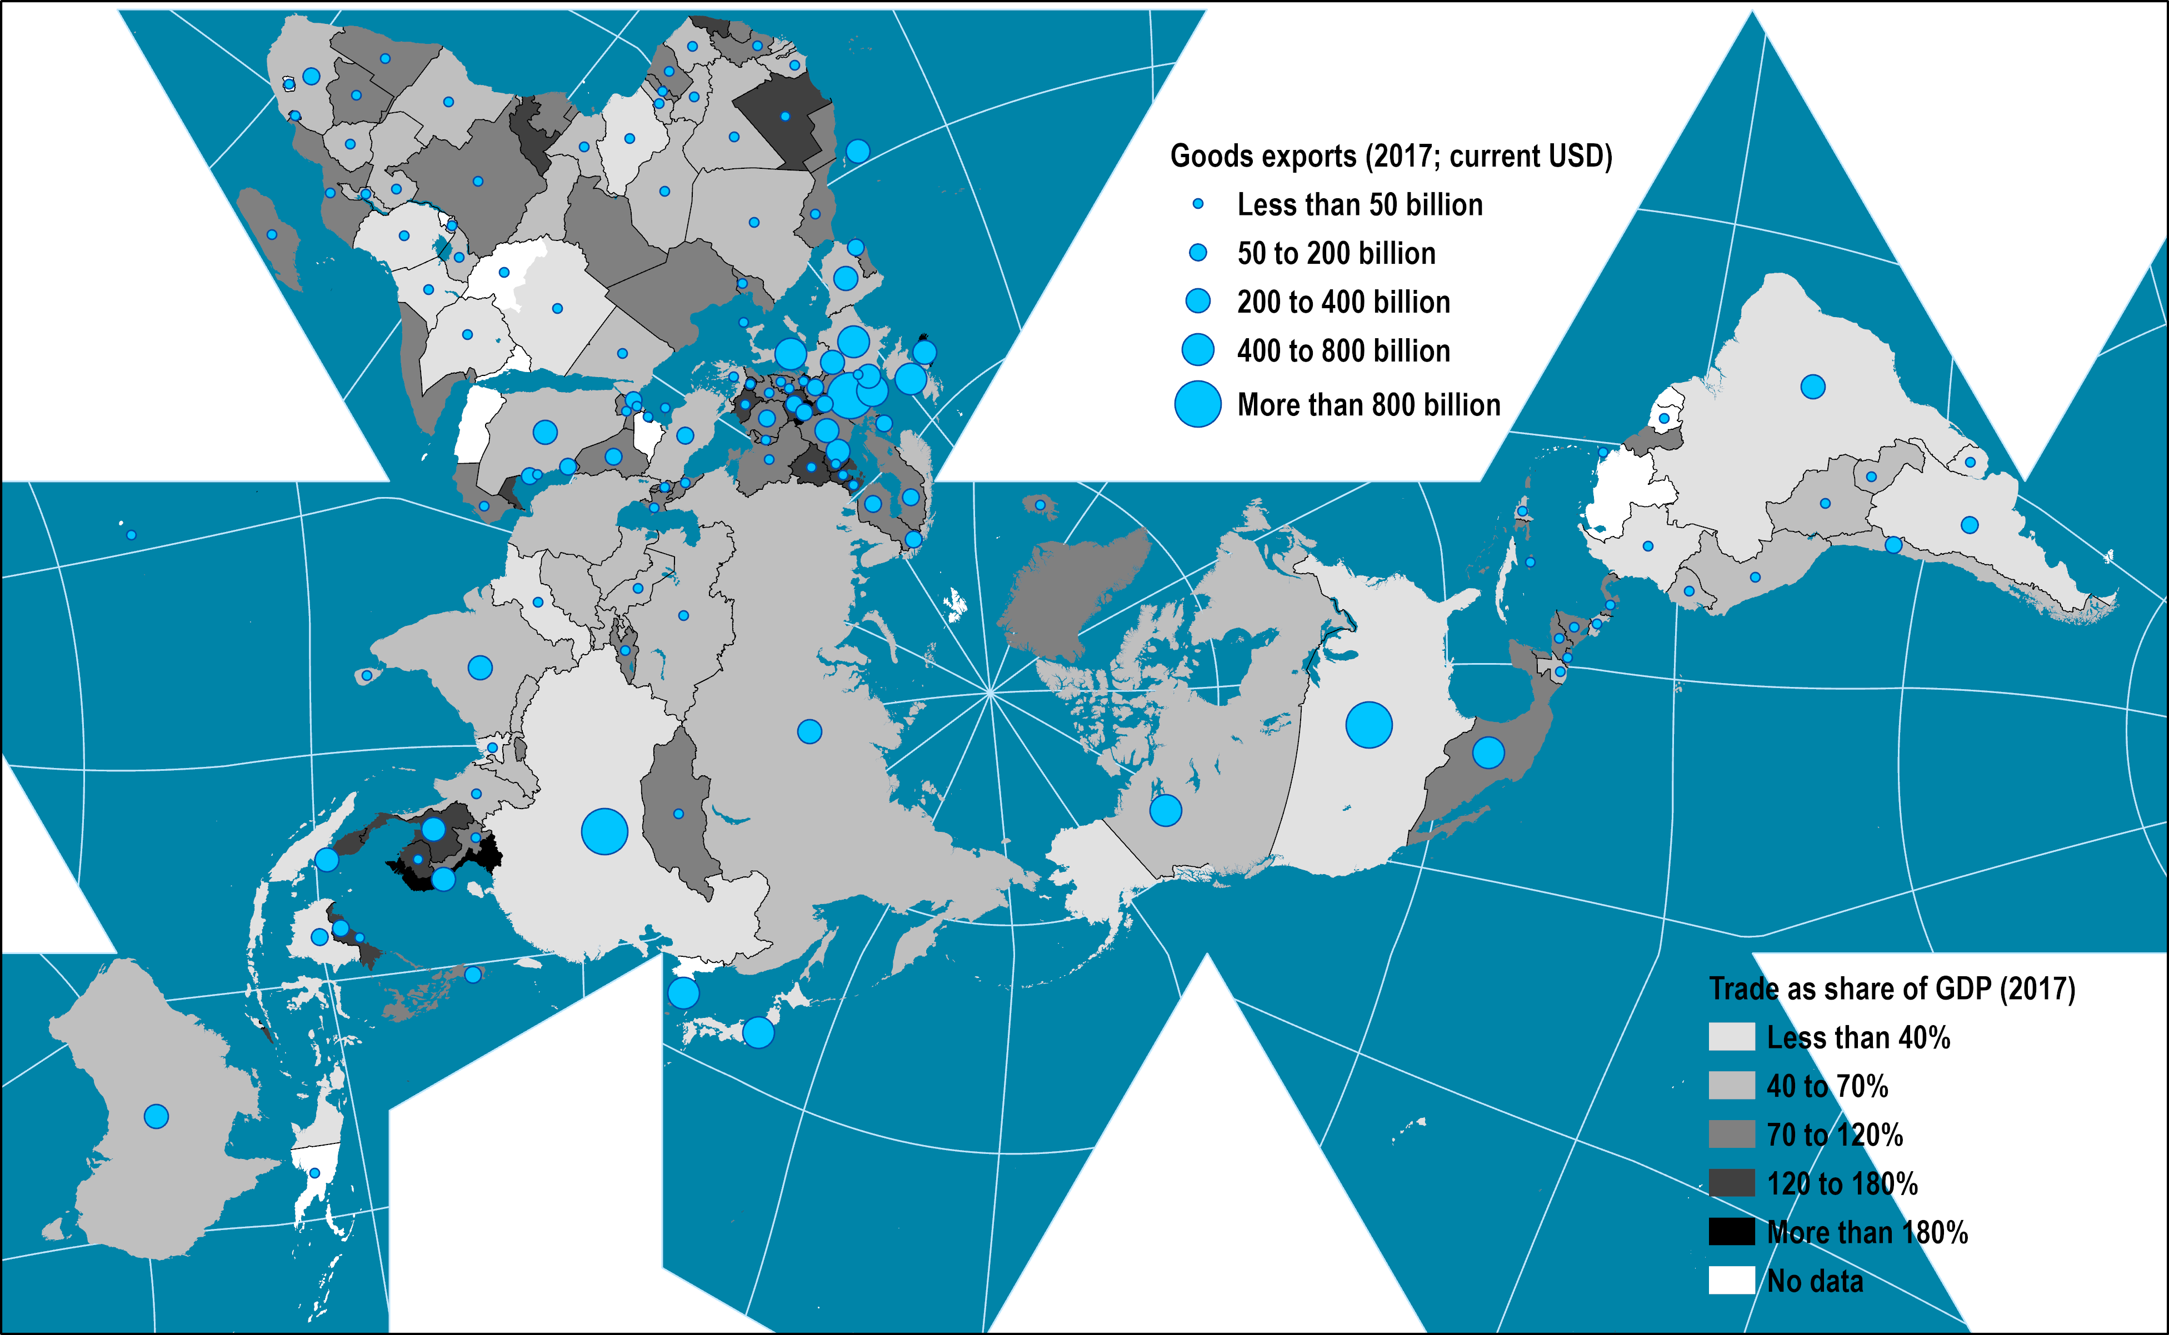
Global Trade, 2017
Notes:
Source: World Bank.
Map location: global_socioeconomic
European Union: 5.9096
North America: 1.96712
China, Japan, Korea, Taiwan: 2.26335 + .698131 + .573694
World 17.8456

Slide 34
Trade Within and Between Corporations
Between Corporations (66%)
Nation
State
Nation
State
Trade
Within Corporations (33%)

Slide 35
GATT Rounds
Year | Round | Action
1947 | Geneva | 45,000 reductions in bilateral tariffs covering 20% of world trade.
1949 | Annency, France | 5,000 reductions in bilateral tariffs.
1951 | Torquay, England | 8,700 reductions in bilateral tariffs covering a new range of goods.
1955-56 | Geneva | Reductions in bilateral tariffs.
1960-62 | Dillon Round | Reductions in bilateral tariffs. EEC talks begin.
1964-67 | Kennedy Round | Reductions in bilateral tariffs. Negotiation rules established.
1973-79 | Tokyo Round | Reductions in bilateral tariffs. Procedures on dispute resolution, dumping and licensing.
1986-93 | Uruguay Round | Additional tariff reductions. Stalemate for agricultural tariffs.
1995 | WTO established | WTO replaced the GATT.
2001-08 | Doha Round | Divergences between developing and developed countries. Issues over agricultural subsidies.
Notes:
Source: adapted from W.J. Bernstein (2008) A Splendid Exchange: How Trade Shaped the World, New York: Atlantic Monthly Press, p. 358

Slide 36
Average Tariffs after the Uruguay Round (%)
Notes:
Source: Abreu, M. (1996), ‘Trade in manufactures: the outcome of the Uruguay Round and developing country interests’ in Martin, W. and Winters, L. A. (eds.), The Uruguay Round and the Developing Countries, Cambridge University Press, Cambridge.

Slide 37
Regional Averages in Trading Across Borders, 2012
Notes:
Source: IFT/World Bank (2013) “Trading across borders”, Doing Business database. www.doingbusiness.org

Slide 38
Participation of Developing Economies in Global Seaborne Trade (% of World Tonnage)
Notes:
Source: Adapted from UNCTAD, Review of Maritime Transport

Slide 39
Impacts of Integration Processes on Networks and Flows
Before Integration
After Integration
Network
International border
Flows

Slide 40
Characteristics of Free Trade Zones
Infrastructures | High level of infrastructure, such as land, transport, office space, utilities, logistics services, business services and other facilities.
Regulations | Streamlined to improve efficiency, including custom services, labor regulation and permits.
Location | High accessibility location, often close to major terminal facilities such as a port, inland terminal or an airport. Location often away from conventional industry.
Export-oriented | Activities operating within the zone produce mainly or exclusively for foreign markets.
Incentives | Variety of incentives, including low cost land, infrastructures, tax and duty exemptions or various subsidies.
Notes:
Source: adapted from Kusago, T and Tzannatos, Z. (1998) “Export processing zones: A review in need of an update”, SP Discussion Paper No. 9802. The
World Bank.

Slide 41
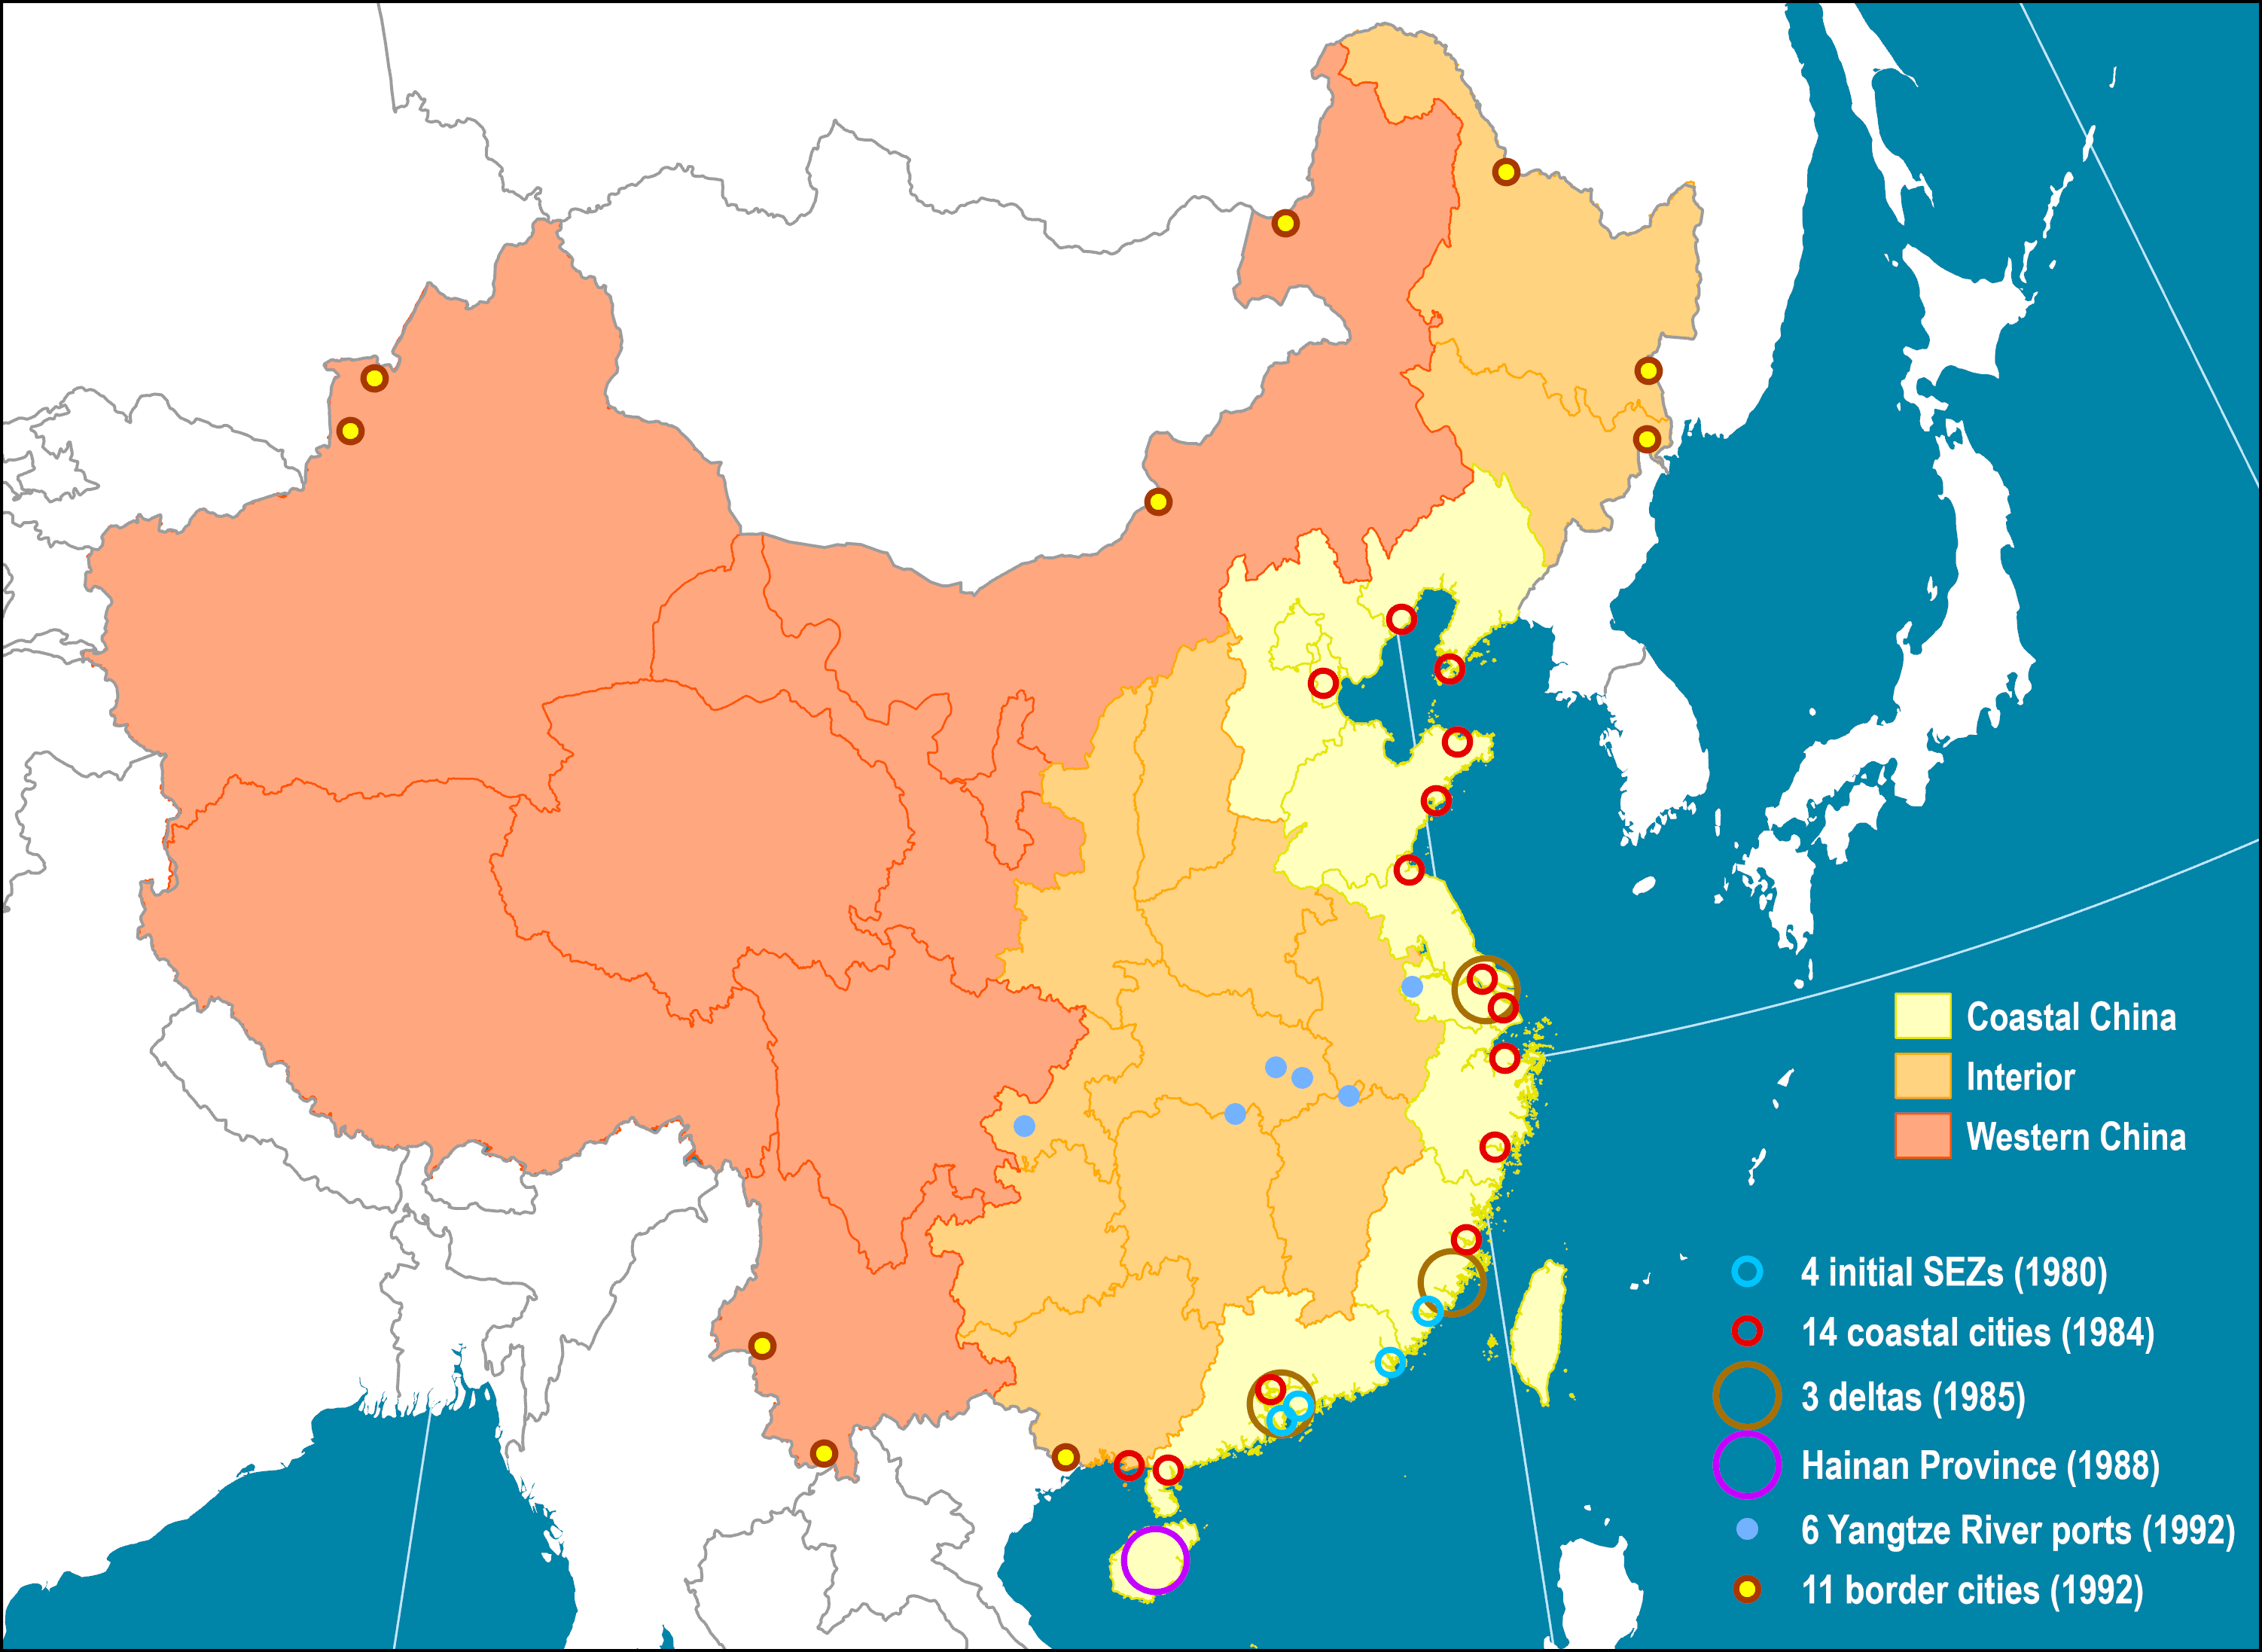
China’s Special Economic Zones
Notes:
Source: adapted from World Bank (2009) World Development Report 2009: Reshaping Economic Geography.
Map location: china

Slide 42
Value of Chinese Exports and FDI, 1983-2018 (Billions of $US)
Notes:
Source: WTO and UNCTAD.

Slide 43
Yuan Exchange Rate (per USD), 1981-2020 (Monthly)
Notes:
Source: http://research.stlouisfed.org/fred2/series/EXCHUS/downloaddata?cid=95

Slide 44
The Main Dimensions of Trade Facilitation
Integration-Based
Customs procedures, regulations and handling of trade documentation.
Compliance to rules and regulations.
Distribution-Based
Multimodal and intermodal freight transport systems.
Modes, infrastructures and terminals.
Physical capacity to support trade.
Transactions-Based
Banking, finance and insurance activities where accounts can be settled.
Setting transactions and receiving compensation.

Slide 45

The “Four Ts” in International Trade
Transaction costs
International
Trade
Tariff and non-tariff costs
Transport costs
Time costs
Notes:
Source: Spulber, D.F. (2007) Global Competitive Strategy, Cambridge: Cambridge University Press.

Slide 46
Phases of the Export-Oriented Paradigm
 | Phase I | Phase II | Phase III
Capital | Currency devaluation. Mostly Foreign Direct Investments (FDI). | Surge in FDI, but growing share of national capital. | Pressures to revalue currency. Drop in FDI. National capital dominant. Providing FDI to other markets.
Production | Numerous comparative advantage. Focusing on labor intensive activities. | Gradual shift to added value production. | Loss of comparative advantages in labor intensive activities. Growing importance of the national market.
Trade | Growth of exports and widening trade balance (imports versus exports). | Peak trade growth and imbalances. | Re-balancing. Relative decline of the share exports in relation to imports.
Transportation | Modernization of existing gateways. | Massive investments in new transport terminals, mostly ports and airports. | Focus on inland transportation.

Slide 47
Changes in the Value World’s Merchandise Trade, Production and GDP, 1950-2018 (in %)
Notes:
Source: WTO, Table A-1. Recession data from National Bureau of Economic Research.

Slide 48
Changes in the Value of World Trade per Type of Merchandise, 1950-2012 (in %)
Notes:
Source: WTO, Table A-1. Recession data from National Bureau of Economic Research.

Slide 49
CPB World Trade Index by Volume, 1991-2017 (2005=100)
Notes:
Source: CPB World Trade Monitor. https://www.cpb.nl/en/worldtrademonitor
Using trade volumes.

Slide 50
CPB World Trade Index by Volume, 2000-2020 (2010=100)
Notes:
Source: CPB World Trade Monitor. https://www.cpb.nl/en/worldtrademonitor
Using trade volumes.

Slide 51
CPB World Trade Index by Value, 2000-2020 (2010=100)
Notes:
Source: CPB World Trade Monitor. https://www.cpb.nl/en/worldtrademonitor
Using trade value.

Slide 52
Monthly Value of Exports or Imports, Selected Traders, 2006-2012 (Jan 2006=100)
Notes:
Source: WTO. http://www.wto.org/english/res_e/statis_e/quarterly_world_exp_e.htm

Slide 53
Share of Product Groups in World Merchandise Trade, 1900-2015
Notes:
Source: adapted from WTO, World Trade Report.

Slide 54
Share of Merchandise Exports by Region, 1948-2012
Notes:
Source: WTO

Slide 55
Share of Merchandise Exports by Region, 1948-2018

Slide 56
World’s 20 Largest Exporters and Importers, 2015
Notes:
Source: WTO

Slide 57
World’s 20 Largest Exporters and Importers of Goods and Services, 2018
Notes:
Source: WTO
https://data.worldbank.org/indicator/NE.EXP.GNFS.CD

Slide 58
World’s Largest Exporters and Importers, 2011
Notes:
Source: WTO

Slide 59
American and Canadian Trade, 1970-2007 (Current USD)
Notes:
Source: WTO. https://www.census.gov/foreign-trade/balance/c1220.html

Slide 60
Monthly Trade between China and the United States, Billions of USD (1985-2019)
Notes:
Source: http://www.census.gov/foreign-trade/balance/c5700.html

Slide 61
Personal Consumption Expenditures, United States 2010
Notes:
Source: Hale, G. and B. Hobijn (2011) “The U.S. Content of “Made in China”, FRBSF Economic Letter http://www.frbsf.org/publications/economics/letter/2011/el2011-25.html

Slide 62
Share of World Goods Exports, Leading Exporters, 1950-2018
Notes:
Source: WTO.
https://data.worldbank.org/indicator/TX.VAL.MRCH.CD.WT

Slide 63
Total Freight Costs for Imports in World Trade (% of Total Costs)
Notes:
Source: UNCTAD Secretariat estimates based on data supplied by the IMF from UNCTAD Review of Maritime Transport, 2002

Slide 64
Merchandise Exports by Trade Agreement, 2005
Notes:
Source: WTO

Slide 65
Merchandise Exports by Trade Agreement, 2015 (in billions USD)
Notes:
Source: WTO.

Slide 66
Freight Transportation and Value Chains

Slide 67
Elements of an Economic System
Production (Supply)
Labor
Regulation
Manufacturing
Land
Capital
Distribution
Consumption (Demand)

Slide 68
The Corporation as a Decision, Management and Planning Unit
 | Management Unit | Decision Unit | Planning Unit
Nature | Maintain operational conditions. | Decisions about the allocation of resources. | Anticipate market changes and opportunities. Allocate its factors of production.
Scope | Production, sales, marketing, payroll, distribution. | Financial, labor, raw materials, research and development, etc. | Economic, technological, social and political change.
Time frame | Short term (production cycles). | Short to long term (product cycles). | Medium to long term (business cycles).

Slide 69
The Corporation and its Expansion
Vertical Integration
Horizontal Integration
Outsourcing
Supply Chain
Firm
Competitors
Expand backward (suppliers) or forward (customers) along the supply chain.
Acquiring or merging with competitors.
Some activities performed by another corporation.
Nature
Lower costs. Enhance and protect product quality. Improve supply chain efficiency.
Economies of scale. Product differentiation. Business model replication. Oligopoly.
Reduce costs. Focus on core competencies. Increase output.
Goals
Higher cost structure of suppliers. More difficult to adapt to changes.
Different business cultures. Anti-monopolistic responses.
Dependency. Loss of competency.
Issues

Slide 70



Types of Corporations by Multinational Expansion Strategy
Raw Material Seekers
Market Seekers
Low Cost Seekers
Knowledge Seekers
Lower input costs
Resource acquisition
First MNCs to emerge
Achieve economies of scale
Expand market
Large investors
Look for comparative advantages
Lower production and distribution costs
Remain competitive
Look for qualified labor, techniques and processes
Increase innovative capabilities
Energy, mining, agricultural, forest
Retailing, wholesalers
Manufacturing
Information technologies, pharmaceuticals

Slide 71
Offshoring, Nearshoring and Farshoring
Within the Firm
Outsourcing
Same Country
Offshoring
Transfer of an organizational function to another country.
Nearshoring
Moving activities in a neighboring country (cultural affinity, similar time zones).
Farshoring
Moving activities to countries in another continent (different time zones).

Slide 72
Private Firms Directly and Indirectly Related to Freight Distribution
 | Function | Infrastructure
Transport firms | Physical movements of goods | Modes
Terminal operators | Management and operation of terminal assets | Terminal equipment
Logistic service providers (third and fourth party) | Management of transportation physical and information assets | Stakes in transportation assets
Commodity producers | Extraction and transformation of raw materials | Storage facilities and terminal equipment
Manufacturers | Production of intermediate and final goods | Distribution centers
Retailers | Procurement and sale of final consumption goods | Distribution centers and delivery

Slide 73
Industrial Agglomeration and Transportation
Diffused
Agglomerated
Corridor
Factory
Manufacturing cluster

Slide 74
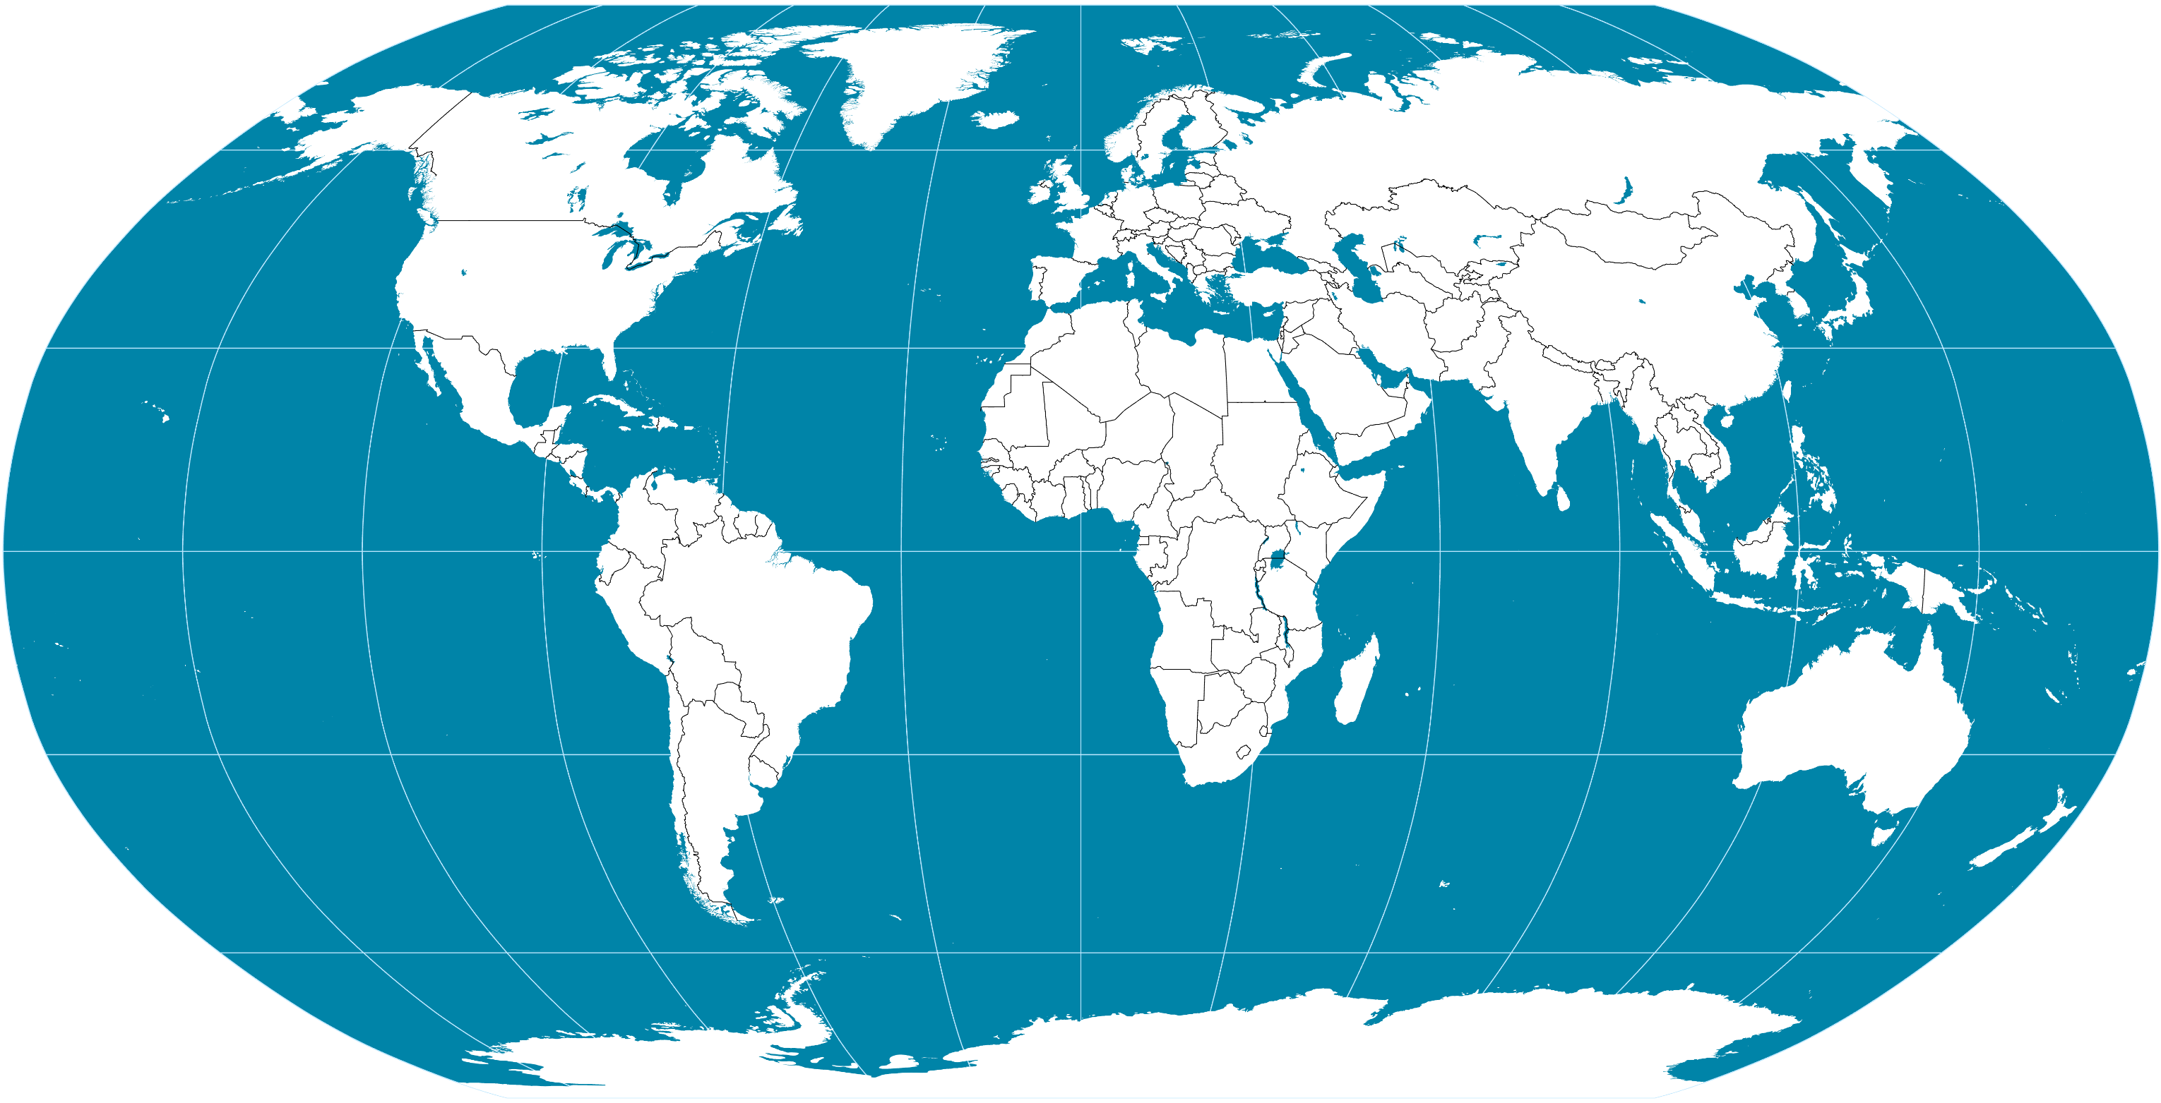
Disconnection of Global Production and Distribution
Core Base
R&D
Distribution
Marketing/Retail
Manufacturing Base

Slide 75
Manufacturing Cost Structure
Direct
Parts and materials
Wages and benefits
Prime Costs
Operational expenses
Factory Costs
Indirect
Factory overheads
Total Costs
Administrative overheads
Net Selling Price
Selling overheads
Distribution costs
Research & Development
Profit
Notes:
Source: adapted from UNIDO (2000) Structure of Production Costs in Footwear Manufacture. http://www.unido.org/fileadmin/import/userfiles/timminsk/leatherpanel14schmelcosts.pdf

Slide 76
Types of Internationalization in Manufacturing
GLOBALLY INTEGRATED
CORPORATION
MULTIDOMESTIC
CORPORATION
HIGH
TRADING INDUSTRIES
GLOBALLY INTEGRATED
INDUSTRIES
Production system located in several countries.
Complex products or resources.
Interdependency in productivity.
Importance of logistics.
Independent operations.
Simple products.
Production can be integrated globally, while the marketing is multidomestic.
Better answer the needs of every market.
Independency in productivity.
Aerospace
Military hardware
Diamond mining
Agriculture
Automotive
Petroleum
Semiconductors
Consumer electronics
International Trade
DOMESTIC INDUSTRIES
MULTIDOMESTIC
INDUSTRIES
Railways
Hospitals
Personal care
Retail banking
Hotels
Consulting
LOW
LOW
Foreign Direct Investment
HIGH

Slide 77
Major Components to Price Reductions by the Chinese Manufacturing Sector, 2005
Notes:
Source: Navarro, P. (2006) Report of “The China Price Project”, Merage School of Business, University of California-Irvine, http://www.peternavarro.com/sitebuildercontent/sitebuilderfiles/chinapricereport.pdf

Slide 78
Share of the World Commodity Consumption, China and United States, c2009/10
Notes:
Sources: United States Geological Survey (2009), BP Statistical Review of World Energy (2010), Food and Agriculture Organization of the United Nations (2008), International Monetary Fund (2010), United States Department of Agriculture (2010).
http://www.fas.usda.gov/psdonline/psdHome.aspx

Slide 79
Sectors of American Imports of Asian Goods Through Maritime Container Shipping, 2004 (in TEUs)
Notes:
Source: adapted from Robert C. Leachman (2005) Port and Modal Elasticity Study, Dept. of Industrial Engineering and Operations Research, University of California at Berkeley. http://www.metrans.org/nuf/documents/Leachman.pdf

Slide 80
Benefits of Improved Freight Transportation on Value Chains
Direct
Cost reductions to carriers and shippers.
Reduced transit times.
Increased reliability of shipments.
Indirect
Improvements in logistics and sourcing.
Lower inventory levels and costs.
Induced
Lower costs for suppliers and customers.
Improved diversity of parts and goods.
Notes:
Source: adapted from ICF Consulting (2002) Economic Effects of Transportation: The Freight Story. http://www.icfconsulting.com/Publications/doc_files/FHWA%20Freight%20Story.pdf

Slide 81
The Transition Towards Manufacturing Capabilities
High
Share of Manufacturing
A
B
Added-value / Complexity
Comparative
Advantages
Competitiveness
Capabilities
Low
GDP per capita

Slide 82
The Value Chain (or Commodity Chain)
Stages
1. Commodities
2. Intermediate Goods
3. Final Goods
Raw Materials
S
Manufacturing and Assembly
WH
Distribution
DC
Market
Storage
Warehouse
Distribution center
Attributable to climatic (agricultural products, forestry products) or geological (ores and fossil fuels) conditions.
Transformation conferring added value. Materials and parts used to make other goods.
Goods shipped to large consumption markets (cities). Flow and inventory management.
Flows
Bulk Shipping
Unit Shipping
LTL Shipping
Market
Transport Chain
High volumes
Low frequency
Average volumes
High frequency
Low volumes
High frequency

Slide 83
Value Chains and Types of Transported Freight
Raw materials
Semi-finished products
Manufactured goods
Extraction
Intra-industrial linkages
Transfer
Processing
Distribution
Manufacturing
Retailing

Slide 84
Commodity Chain Analysis
Stages
Raw Materials
Manufacturing and Assembly
Distribution
Market
Locations
Channels
Nation
International
Nation
City
Modes
Rail
Rail
Maritime
Maritime
Road
Road
Load units
Bulk shipping
Unit shipping
TL/LTL shipping
LTL shipping
Costs
Procurement Costs
Manufacturing
Costs
Distribution
Costs
Retailing Costs
Added value
Collection
Storage
Extraction
Manufacturing
Assembly
Customization
Delivery
Sales / services

Slide 85
Generic Smile Curve in a Value Chain
Patent &
Technology
Brand & Service
Added Value
Fabrication
R&D
(Global Competition)
Marketing
(Area Competition)

Slide 86
The Value Chain and its Added Value
Concept
Fabrication
Logistics
1. R&D
High
1
7
2. Design / Branding
3. Procurement
2
6
4. Manufacturing
Added Value
5. Distribution
3
5
6. Marketing
7. Sales / Services
4
Low
Pre-Production
(Intangible)
Production
(Tangible Activities)
Post-Production
(Intangible)
Value Chain
Notes:
Source: Adapted from the Stan Shih “Smile Curve” concept.

Slide 87
Upgrading the Value Chain
Focus on fabrication; suppliers assemble inputs, following buyers’ specifications.
Inputs may be imported due to limited availability and quality concerns over local inputs.
Product focus may be relatively narrow.
1. Fabrication
(Value chain entry)
Fabrication
1
Broader range of manufacturing-related functions, such as sourcing inputs and inbound logistics as well as fabrication.
The supplier may also take on outbound distribution activities.
2. Supply Chain
(Functional upgrading)
Procurement
Distribution
2
1
2
Design
Supplier carries out part of the pre-production processes such as design or product development.
Design may be in collaboration with the buyer, or the buyer may attach its brand to a product designed by the supplier.
3. Product Design
(Functional upgrading)
3
2
1
2
Marketing
Supplier acquires post-production capabilities and can fully develop products under its own brand names.
Can be in collaboration with the buyer or by establishing a new market channel.
4. Product Brand
(Functional upgrading)
3
4
2
1
2
R&D
Services
Increase unit value by producing more complex products, which requires increasing the capabilities of the firm.
Countries must move from low-cost commodities to higher value goods that warrant higher returns as labor costs increase.
Product upgrading
3
4
2
1
2
R&D
Services
Improving productivity through new capital investments.
Improving IT and logistics.
Reducing lead time and increasing the flexibility of the supply chain process.
Process upgrading
3
4
2
1
2
Notes:
Source: adapted from K. Fernandez-Stark, S. Frederick and G. Gereffi (2011) The Apparel Global Value Chain: Economic Upgrading and Workforce Development, Duke University Center on Globalization, Governance and Competitiveness.

Slide 88
Value Creation and Capture, iPhone 4 (in USD)
Korea
Inputs ($80.05)
Distribution
($90.00)
Germany
Inputs ($16.08)
Inputs ($24.63)
Retail
($600)
($329.95)
USA
China
France
Inputs ($3.25)
Misc.
($45.95)
Factory Gate Price
($194.04)
VA ($6.54)
Japan
Inputs ($0.70)
Apple
($269.05)
Other
Inputs ($62.79)
Notes:
Source: adapted from OECD (2011) "Global Value Chains: Preliminary Evidence and Policy Issues," Organisation for Economic Co-operation and Development, DSTI/IND(2011)3, Paris, 2011.

Slide 89
Cost to Manufacture a Cotton Vest, Asia and United States, 2013
Notes:
Source: NY Times, Sept 19, 2013

Slide 90
Freight Transport Costs as Share of Commodity Market Value
 | 1970 | 1980 | 1990 | 2007
Jute (Bangladesh) | 12.1% | 19.8% | 21.2% | 44.2%
Tea (Sri Lanka) | 9.5% | 9.9% | 10.0% | 13.4%
Coffee (Colombia) | 4.2% | 3.3% | 6.8% | 2.5%
Cocoa beans (Ghana) | 2.4% | 2.7% | 6.7% | 3.5%
Notes:
Source: UNCTAD, Review of Maritime Transport

Slide 91
Supply Chains, Transport Chains and Added Value
Added Value
Transport Chain
Supply Chain
Customers
Customer
High
Distribution
Center
Upward
Value Capture / Creation
Market Potential
Value Expansion
Where?
How?
Distribution Efficiency
Value Retention
Port
Production Costs
Low
Downward
Supplier
Suppliers

Slide 92


Global Production Networks
Space
(Differences in input costs and market potential)
Goods (Differences in manufacturing capabilities)
Links/Flows
(Differences in distribution efficiency)
GLOBAL
PRODUCTION
NETWORKS
Value Chain

Slide 93
Geographical and Functional Integration in Value Chains
Regional Value
Chain
Supplying
Manufacturing
Distribution
S
S
M
M
Orders
D
Origin / Destination
Relationships
D
Physical Flows
Supply / Demand Relationships
S
M
1
2
D
4
Value Chain
S
M
D
3
Global
Value Chain
S
M
Functional Integration
Geographical Integration
Notes:
Source: adapted from Rodrigue, J-P (2006) "Transportation and the Geographical and Functional Integration of Global Production Networks", Growth and Change. Vol. 37, No. 4, pp. 510-525.

Slide 94
Producer and Buyer-driven Value Chains
Producer-driven
Manufacturers
Distributors
Retailers and Dealers
Domestic and foreign subsidiaries and subcontractors
Buyer-driven
International
National
Branded Marketers
Traders
Factories
Retailers
Overseas Buyers
Branded Manufacturers
Notes:
Source: adapted from G. Gereffi (2001) “Shifting Governance Structures in Global Commodity Chains, With Special Reference to the Internet”, American Behavioral Scientist, Vol. 44 No. 10, pp. 1616-1637.

Slide 95
Characteristics of Producer-Driven and Buyer-Driven Global Commodity Chains
 | Producer-Driven Commodity Chains | Buyer-Driven Commodity Chains
Drivers of Global Commodity Chains | Industrial capital | Commercial capital
Core Competencies | Research & Development; Production | Design; Marketing
Barriers to Entry | Economies of Scale | Economies of Scope
Economic Sectors | Consumer Durables; Intermediate Goods; Capital Goods | Consumer Nondurables
Typical Industries | Automobiles; Computers; Aircraft | Apparel; Footwear; Toys
Ownership of Manufacturing Firms | Transnational Firms | Local Firms, predominantly in developing countries
Main Network Links | Investment-based | Trade-based
Predominant Network Structure | Vertical | Horizontal
Notes:
Source: adapted from G. Gereffi (1999) A Commodity Chains Framework for Analyzing Global Industries, www.yale.edu/ccr/gereffi.doc

Slide 96
Product Life Cycle
Monopoly
Competition
Sales
Competitors
Innovating firm
Idea
Promotion
First competitors
Mass production
Obsolescence
Research and
development
Growth
Maturity
Decline
Stage 1
Stage 2
Stage 3
Stage 4

Slide 97
CRB Index (CCI), Monthly Close, 1970-2013
C
B
II
III
I
a
1
2
b
c
A
3
d
4
5
Notes:
Source: Commodity Research Bureau. http://www.crbtrader.com/crbindex/
http://www.crbtrader.com/data.asp?page=chart&page=chart&sym=CIY00
http://www.quandl.com/data/RICI/RICI-Euronext-Rogers-International-Commodity-Index

Slide 98
Rogers International Commodity Index 1999-2016
Notes:
http://www.quandl.com/data/RICI/RICI-Euronext-Rogers-International-Commodity-Index

Slide 99
Global Merchandises Exports by Product, 1990-2005 (in % of value)
Notes:
Source: WTO.

Slide 100
Geographical Growth of a Multinational Corporation
1
2
Tariff
Basic Enterprise
Penetration of a National Market
Regional
National
International
Factory
Distribution center
Representative
Penetration of Foreign Markets
Multinational Corporation
3
4
Notes:
Source: adapted from Fischer, A. (1994) Industrie et espace géographique, Paris: Masson.

Slide 101
Global Production Networks and Location Strategies
Country A
Country B
Centralized Production
Regional Production
Country C
Country D
Multidomestic
Regional Specialization
Vertical Integration
Globally Integrated
Notes:
Source: Adapted from Knox and Agnew (1998) The Geography of the World Economy, Third Edition, London: Arnold

Slide 102
The Velocity of Freight
Transshipment Speed
Speed barrier
Future improvements
Pull Logistics
Logistical threshold
Containerization
Push Logistics
Shipment Speed

Slide 103
Market Share by Freight Transport Mode, Western Europe, 1980-2002 (in ton-km)
Notes:
Source: European Conference of Transport Ministers, 2002.

Slide 104
Market Share by Freight Transport Mode, United States, 1965-2005 (in ton-miles)
Notes:
Source: BTS.
http://www.rita.dot.gov/bts/sites/rita.dot.gov.bts/files/publications/national_transportation_statistics/html/table_01_50.html

Slide 105
Fluxes in a Fordist and Post-Fordist Production System
Fordism
Post-Fordism
Raw materials
and parts
Manufacturing
Sales and
distribution

Slide 106
Fordist and Post-Fordist Production Structure
Characteristics | Fordism | Post-Fordism
Production Mode | Mass Production | Mass Customization
Organization | Structured (Pyramidal) | Networked (Flexible)
Focus | Supply | Demand
Market Reach | Regional / National | Global
Expansion | Vertical or horizontal integration | Outsourcing and offshoring
Core Resources | Physical Assets | Innovation/ Knowledge
Value Chains | Discontinuous | Integrated (continuous)
Inventories | Months | Hours
Production Cycle Time | Weeks / Months | Days
Information | Monthly / Weekly | Daily / Real-Time
Product Life Cycle | Years | Months
Quality | Affordable Best | Zero-Defect

Slide 107





Post-Industrial Revolution
Economic Composition
Labor
Relative: shift from manufacturing to services.
Absolute: growth of manufacturing.
Declining importance of “blue collar” tasks.
Increasing importance of technical and creative tasks.
Capital Accumulation
Knowledge becomes a form of capital.
High reliance on innovation.
Information Technologies
Global telecommunication networks.
IT embedded in products and services.
Manufacturing
Flexible manufacturing systems.
Supply chain management (Just-in-time).
Diversified trade (from resources to high value goods).

Slide 108
Level of Embeddedness of Production and Distribution
Embeddedness
Pure
Standardization
Segmented
Standardization
Customized
Standardization
Tailored
Customization
Pure Customization
Design
Design
Design
Design
Design
Parts
Parts
Parts
Parts
Parts
Assembly
Assembly
Assembly
Assembly
Assembly
Distribution
Distribution
Distribution
Distribution
Distribution
Market
Market
Market
Market
Market
Processing without order
Shipment to order
Assembly to order
Manufacturing to order
Design to order
Push (expectation)
Pull (response)
Notes:
Source: adapted from W. Delfmann (2007) “The Changing Role of Gateways in the Context of Global Value Chain Dynamics”, Canada’s Gateway and Corridors Initiative Conference, Vancouver, British Columbia.

Slide 110
The Global Car Production Network, 2003
Mazda
Isuzu
Suzuki
Jaguar
Land Rover
Vauxhall
Opel
Mercedes Benz
Ford
GM
Dailmer Chrysler
Volvo
Aston Martin
Daewoo
Saab
Chrysler
Jeep
Bentley
Skoda
Lancia
Maserati
Toyota
VAG
Fiat
Daihatsu
BMW
Seat
VW
Audi
Ferrari
Alfa Romeo
Rolls Royce
Porsche
Citroen
Nissan
Renault
PSA
Honda
Equity ownership
Joint venture
Equity relationship
Functionally integrated group
Peugeot
Hyundai
Mitsubishi
Notes:
Source: adapted from P. Dicken (2003) Global Production Networks In Europe And East Asia: The Automobile Components Industries, GPN Working Paper 7, University of Manchester, http://www.sed.manchester.ac.uk/geography/research/gpn/gpnwp7.pdf

Slide 111
The Automobile Supply Chain
Supplying
industries
Bodies
Manufacture and stamping of body panels
Body assembling and painting
Steel and other metals
Rubber
Components
Manufacture of mechanical and electrical components (wheels, tires, seats, breaking systems, windshields, exhausts, etc.)
Final Assembly
Consumer market
Electronics
Plastic
Glass
Engines and transmissions
Forging and casting of engine and transmission components
Machining and assembly of engines and transmissions
Textiles
Notes:
Source: adapted from P. Dicken (2003) Global Production Networks In Europe And East Asia: The Automobile Components Industries, GPN Working Paper 7, University of Manchester, http://www.sed.manchester.ac.uk/geography/research/gpn/gpnwp7.pdf

Slide 112
Cereals Supply Chain
Extraction
Manufacturing
Farm
Grain
Processing Facility
Cereal
Distribution and Retailing
Packaged Cereal
Converter
Packaging
Distributor
Store
Paperboard
Wood Pulp
Packaged Cereal
Wood Pulp Mfg
Wood Pulp
Label Mfg
Labels

Slide 113
The Scope of a Supply Chain, Logistics Chains and Transport Chains
Supply Chain
Montagem
Distribuição
Vendas
Production
planning
Storage
Gate
Gate
Order
planning
Sorting
Storage
Sorting
Gate
Gate
Order
planning
Foco no Produto
LC 2
LC 3
Logistics Chain 4
Extração
Processamento
Fabricação
Montagem
Distribuição
Varejo
Transport Chain 1
TC 2
TC 3
TC 4
TC 5
Foco no Transporte
Extração
Processamento
Gate
Ferro
Porto
Porto
Marítimo
Rodovia
Gate
Notes:
Source: adapted from L. Ramstedt and J. Woxenius (2006) Modelling approaches to operational decision-making in freight transport chains. the 18th Nofoma conference, Oslo, 8-9 June 2006.

Slide 114
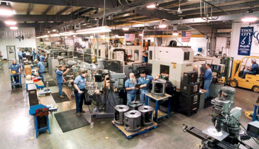
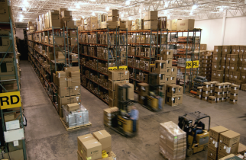
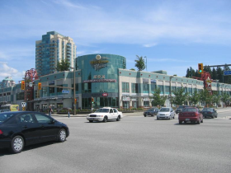
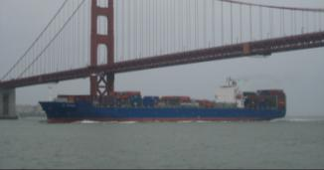
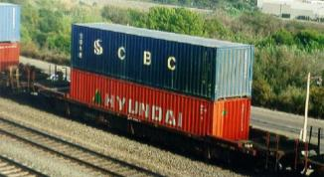
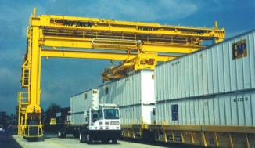
Supply Chains: Alternating First and Last Miles
Logistics Chain 1
LC 2
LC 3
Logistics Chain 4
Extraction
Processing
Fabrication
Assembly
Distribution
Retailing
Transport Chain 1
TC 2
TC 3
TC 4
TC 5

Slide 115
Logistics and Freight Distribution

Slide 116
The Concept of Logistics
Demanda derivada
Logística
Gestão de materiais
Distribuição Física
Manufatura
Compras
Inventário
Embalagem
Reciclagem e reuso
Transporte
Armazenagem
Atacado
Varejo
Demanda induzida

Slide 117
Logistics Goals and Operations
Abastecimento (Objetivos)
Demanda (operações)
Pedido
Produto certo
Quantidade certa
Transporte
Manuseio
Embalagem
Entrega
Local correto
Tempo correto
Estoque
Planejamento da produção
Armazenagem
Qualidade
Condições adequadas
Pedidos
Vends
Compras
Preço
Preço competitivo

Slide 118

The Supply Chain and its Cycles
Customer
Customer Order Cycle
Retailer
Inventory
Replenishment Cycle
Time
Distributor
Manufacturing Cycle
Manufacturer
Procurement Cycle
Supplier
Notes:
A sequence of steps characterizing the transactions that take places among two successive stages of the supply chain.

Slide 119
The Supply Chain and its Cycles
Supply Chain
Customer
Retailer
Distributor
Manufacturer
Supplier
Information Flow
Customer Order Cycle
Replenishment Cycle
Manufacturing Cycle
Procurement Cycle
Inventory
Time

Slide 120
The “Bullwhip Effect” in Supply Chains
Supplier
Manufacturer
Distributor /
Wholesaler
Customer
Retailer
Customer Order Cycle
Replenishment Cycle
Manufacturing Cycle
Procurement Cycle
Order 10 units
Order 12 units
Order 15 units
Order 20 units

Slide 121

Distribution and Related Logistics Activities
Inventory
Inventory
Truckload
Supplier
Customer
Quote price
Receive order
Item price list
Place order
Pay invoice
Shipper
Receiver
Tender shipment
Schedule shipment
Prepare shipment
Load shipment
Trace shipment
Issue invoice
Carrier
Schedule dock space
Receive shipment
Unload product
Unpack shipment
Receive freight bill
Pay freight bill
Dispatch truck
Trace shipment
Collect delivery receipt
Send billing
Collect payment
Rates
Information flow
Physical flow
Notes:
Source: Adapted from P.O. Roberts (2003) Supply Chain Management: New Directions for Developing Economies, PSD Professionals’ Forum.

Slide 122
Value-Added Functions and Differentiation of Supply Chains
Value-Added Functions
Supply Chain Differentiation
Logistics Costs
Important
Low costs and stability of cost structure.
Inversely proportional to cargo value.
Production Costs
Transit Time
Marginal
Low inventory carrying costs and lead time.
Proportional to cargo value and perishability.
Location
Time
Reliability
Very Important
Stability of delivery schedule and conditions.
Related to cargo type.
Control
Risk
Marginal
Low cost, time and reliability deviation.
Related to transport chain.

Slide 123
Taxonomy of Logistics Decisions
Level | Description
Production structures | Commercial decisions on outsourcing, offshoring and sub-contracting. Number, location and capacity of production units.
Transport structures | Choice of a freight network linking a company and its suppliers and customers. Choice of modes and terminals; the transport chain.
Distribution structures | Choice concerning the number, location and capacity of distribution centers. Frequency and timing of distribution (e.g. just-in-time).
Logistics structures | Usage of production, transport and distribution capabilities to fulfill short, medium and long term strategies (e.g. lower costs, gain market share, improve service efficiency, reduce response time, reduce environmental footprint). Usage of third party logistics providers.
Notes:
Source: adapted from McKinnon, A.C. (1998) “Logistical Restructuring, Freight Traffic Growth and the Environment”, in D. Banister (ed) Transport Policy and the Environment, London: Routledge.

Slide 124
Total Logistics Costs Tradeoff
Custo logístico total
Custos
Custos de armazenagem
Custos de transporte
Número de armazéns ou tamanho do pedido
Notes:
Source: adapted from McKinnon, A. “The Effects of Transport Investment on Logistical Efficiency”, Logistics Research Centre, Heriot-Watt University, Edinburgh, UK.

Slide 125
Logistics Costs and Economic Development
Notes:
Source: World Bank for GDP data (in current dollars). Various sources for logistics costs.

Slide 126
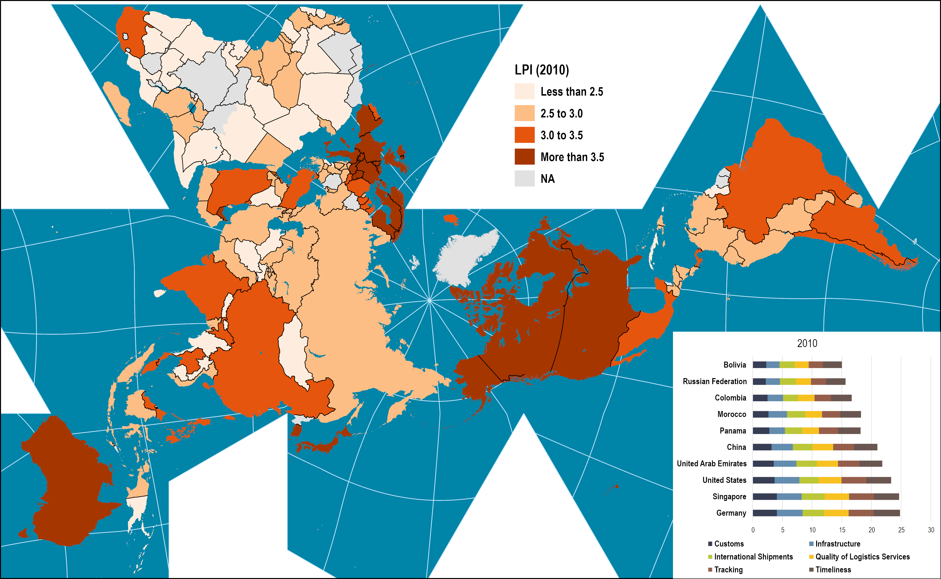
Logistic Performance Index, 2010
Notes:
Source: adapted from World Bank, Logistics Performance Index, http://info.worldbank.org/etools/tradesurvey/mode1b.asp
Map location: logistics_performance

Slide 127
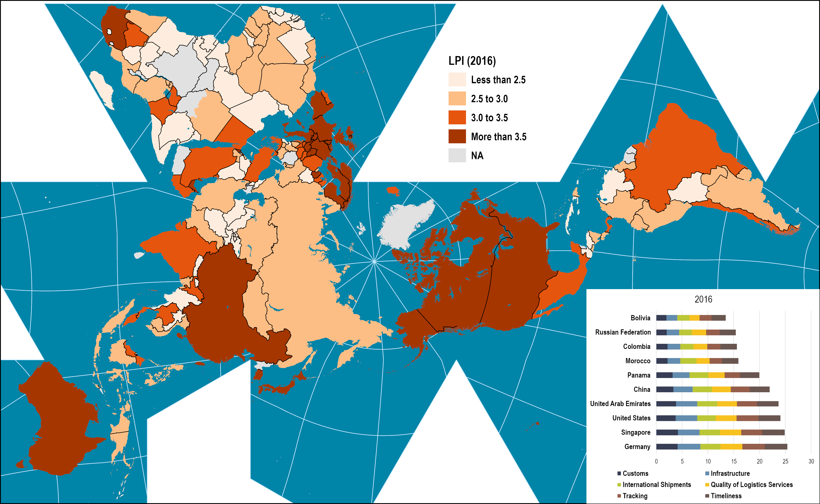
Logistic Performance Index, 2016
Notes:
Map location: logistics_performance

Slide 128
Composition of the Logistics Performance Index, Selected Countries

Slide 129
The Logistics Virtuous and Vicious Cycles
Complex procedures
Regulatory burden
Lack of market forces
Limited incentive to invest
Low quality services
Trade Facilitation
Liberalized market
Incentive to invest
Scale economies
High quality services
Seamless procedures
Vicious
cycle
Virtuous
cycle
Protectionism
Logistics Performance
Logistics
Unfriendly
Partial
Reforms
Comprehensive
Reforms
Logistics
Friendly
Notes:
Source: adapted from Arvis, J-F, G. Raballand, and J-F Marteau (2007) The cost of being landlocked: logistics costs and supply chain reliability, Policy Research Working Paper 4258. World Bank, Washington, D.C. World Bank (2007) Connecting to Compete: Trade Logistics in the Global Economy. The Logistics Performance Index and Its Indicators.

Slide 130
Worldwide Logistics Costs, 2002
Notes:
Source: Adapted from P.O Roberts, Supply Chain Management: New Directions for Developing Economies, http://www.worldbank.org/html/fpd/transport/ports/trf_docs/new_dir.pdf

Slide 131
Global Logistics Costs by Function and Mode, 2018
Rail
Air
Maritime
Trucking
Notes:
Source: Adapted from Armstrong & Associates Inc.

Slide 132
The Evolution of Logistics
1960s
1980s
1990s
2000s
2010s
Fragmentation
Consolidation
Integration
Value Capture
Automation
Demand Forecasting
Sourcing / Purchasing
Materials Management
Requirement Planning
Production Planning
Manufacturing Inventory
Warehousing
Warehousing
Logistics
Supply Chain Management
Materials Handling
Materials Handling
Packaging
Packaging
Goods Inventory
Information Technology
Distribution Planning
Marketing / Sales
Physical Distribution
Order Processing
Strategic Planning
Transportation
Finance
Customer Service

Slide 133
The Evolution of the Scope and Taxonomy of Logistic Areas
SCOPE
1950
1960
1970
1980
1990
2000
2010
Material Management
Logistics
Warehousing
Logistics
Supply Chain Management
Physical Distribution
Palletization
Containerization
Intermodalism
Crossdocking
Transportation
Public Policy
Trade Liberalization
Trade / Export Promotion
Trade Facilitation
Integrated Development
TAXONOMY
Regulations
Free Zones
Free Trade Zones
Export Processing Zones
Special Economic Zones
Terminals
Inland Terminals
Intermodal Terminals
Dry / Inland Ports
Extended Gateways
Activities
Industrial Parks
Logistics Zones
Logistics Platforms
Notes:
Source: Adapted from: T. Notteboom, F. Parola, G. Satta and M. Risitano (2016) “A taxonomy of logistics centres: overcoming conceptual ambiguity”, Transport Reviews, 37(3), pp.1-24.

Slide 134
From Push to Pull Logistics
Push
Pull
Supplier
Supplier
Supplier
Supplier
Supplier
Supplier
Supplier
Supplier
Supplier
Supplier
Freight flow
Manufacturer
Manufacturer
3PL
Distributor
Returns / Recycling
Distributor
Customer
Point-of-sale data
Customer

Slide 135
Changes in the Relative Importance of Logistical Functions in Distribution Systems
Notes:
Source: Federal Highway Administration, Office of Freight Management. http://ops.fhwa.dot.gov/freight/

Slide 136
Benefits of Demand-Driven Supply Systems
Cause
Consequence
Inventory turnover
Working capital
Customer service
Net income
Labor productivity
Operating expenses
Capacity utilization
Return on assets
Logistics costs
Operating expenses
Notes:
Source: adapted from C.B. Lee (2003) “Demand Chain Optimization: Pitfalls and Key Principles”, Evant White Paper Series.

Slide 137
Fragmentation of the Production System and the Logistics Industry
Fragmented
Logistics
Region A
Agglomerated
Supply Chain
Inputs
Outputs
Region B
Factory
Regional manufacturing cluster
Region C
Global supply chain

Slide 138
Logistical Improvements, Manufacturing Sector, 1960s to 2010s
Notes:
Source: Adapted from Logistics Management & Distribution.
Cycle time: The amount of time required from receipt of an order from a customer to shipment of the completed goods.

Slide 139
Some Issues in Supply Chain Management
Issue | Outcome
Location of inventory and production | Wider geographical sourcing and distribution of goods
Development of break-bulk / transshipment systems
Concentration of international trade | Major port and airport gateways
Development of hub and spoke systems | Intermediary hubs,
Time management | Postponement, Nominated day delivery and timed delivery systems
Rationalization of the supply base
Vertical disintegration of production
Direct deliveries
Green logistics | Reverse logistics
Notes:
Source: Zografos, K.G. and A.C. Regan (2004) Current Challenges for Intermodal Freight Transport and Logistics in Europe and the United States. In Transportation Research Record: Journal of the Transportation Research Board, No. 1873, Transportation Research Board of the National Academies, Washington, D.C., pp. 70-78.

Slide 140
Average Order Lead Times of European Manufacturers, Wholesalers, and Retailers
Notes:
Source: A.T. Kearney / ELA
Lead time: The amount of time it takes for a shipment to arrive once an order has been placed. What is remarkable is that in spite of the significant lengthening of supply chains lead times have declined.

Slide 141
Logistics Costs, United States, 1980-2017 (in billions of $)
Notes:
Source: Council of Supply Chain Management Professionals, State of Logistics Report, (after 2012). Logistics Management & Distribution Report (before 2012).
https://leanlogisticsblog.files.wordpress.com/2012/06/logistics-system-cost.png

Slide 142
Logistics Costs as % of GDP
Notes:
Source: CSCMP. Annual State of Logistics Report

Slide 143
% of Products Shipped for “Just-in-Time” Manufacturing
Notes:
Source: T. Hsu, FedEx, 1998.

Slide 144
Conventional and Contemporary Arrangement of Goods Flow
Raw Materials & Parts
Manufacturing
Distribution
Conventional
Customers
Raw
Materials
Storage
National
Distribution
Regional
Storage
Local
Distribution
Retailers
Supply Chain Management
Contemporary
Customers
Raw
Materials
Manufacturing
Distribution
Center
Retailers
Material flow (delivery)
Information flow (order)
Core component
Notes:
Source: adapted from Hesse, M. and J-P Rodrigue (2004) "The Transport Geography of Logistics and Freight Distribution”, Journal of Transport Geography, Vol. 12, No. 3, pp. 171-184.

Slide 145
Logistical Activities Related to Containerization
Container Management | Broking/Leasing. Inventory management. Transport chain routing.
Container Transportation | Maritime shipping (Routing, Scheduling). Terminal operations (Transshipment, Storage/Stacking, Gate access). Inland transportation (Rail operations, Drayage, Repositioning).
Container Handling | Loading (Packing, Palletizing and Bundling). Transloading (Re-bundling). Unloading (Unbundling, de-palletizing and Unpacking).
Container Storage and Maintenance | Empty stacking. Inspection. Cleaning & Repair.

Slide 146
Layers to Logistics Services
Actors
Services
1PL
Manufacturing,
Wholesaling, Retailing
Cargo owners
2PL
Carriers
Transportation
Service integration
Logistics service providers
3PL
Logistics
Lead logistics providers & consultants
4PL
Supply chain management
Supply chain integration

Slide 147
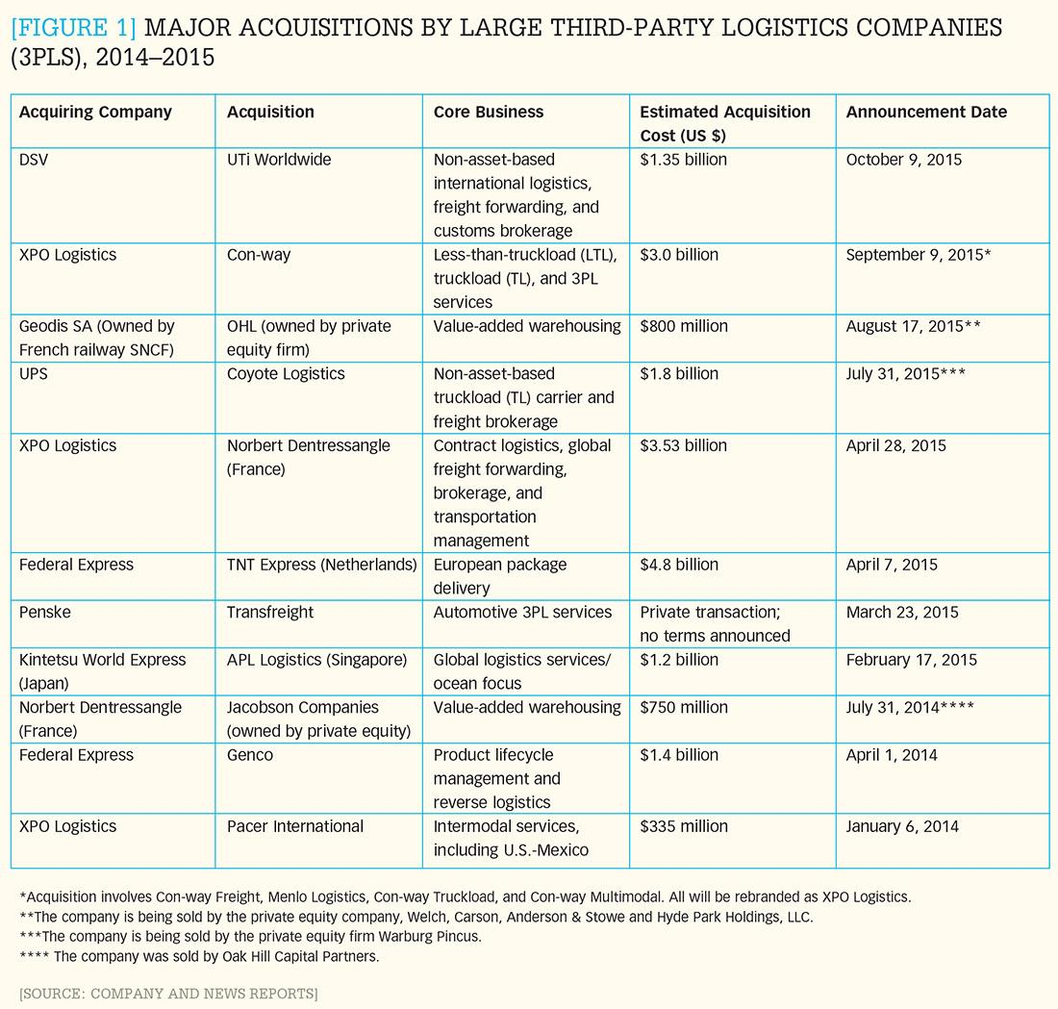

Slide 148




Key Drivers for Third- and Fourth-Party Logistics Providers
Globalization
Innovation & Management
Supply chains and manufacturing increasingly global, requiring greater management of supply chains.
3PLs becoming increasingly sophisticated in supply chain management, making investments, realizing economies of scale.
Core Competencies
Asset Utilization
Manufacturers and retailers are focusing on their core business and outsourcing logistics services to specialized firms.
3PL model promotes greater asset utilization (e.g. balancing flows, backhaul, within their networks) and asset-sharing alliances.

Slide 149
Main Core Competencies of Third Party Logistics Providers
Sourcing
Shipping
Product
Transport
Warehousing
Routing

Slide 150
Services Offered by Third and Fourth Party Logistics Service Providers
3PL ► |  |  | ◄ 4PL
Standard | Advanced | Complete | Integrated
Transportation services Carrier selection Rate negotiation Fleet management Warehousing Cross docking Pick and Pack Distribution (direct to store/home) Dispatching Delivery documentation Shipment consolidation | Vendor managed inventories Stock accounting Customs clearance and documentation Assembly Packaging and labeling Managing product returns Financing Retail delivery, set up and on site training Inventory tracking | Order planning and processing Information and Communications Technologies (ICT) management Single invoice Landed duty paid cost Payment collection Real time inventory updates Just in Time (JIT) inventory management | Production planning Global sourcing Multiple routing options Supply chain consulting Real time supply chain monitoring and adjustment
Notes:
Source: adapted from OECD, Logistics Integration in the Asia-Pacific Region, 2000. CPCS Transcom.

Slide 151
World’s Largest Third Party Logistics Providers, 2013
Notes:
Source: Armstrong & Associates, Inc. Top 50 Global 3PL
http://3plogistics.com/Top_50_Global_3PLs.htm
http://www.supplychain247.com/article/2013_top_50_global_top_30_domestic_3pls

Slide 152
World’s Largest Freight Forwarders, 2015
Notes:
Source: Armstrong & Associates, Inc.
http://www.3plogistics.com/3pl-market-info-resources/3pl-market-information/aas-top-25-global-freight-forwarders-list/

Slide 153
Types of Freight Facilities
Facility
Storage
Distribution
Fabrication
Heavy manufacturing
Manufacturing
Light manufacturing
Intermodal Terminal
Terminals
Bulk or transload terminal
Bulk warehouse
Importance
Storage
Warehouse
High
Multitenant facility
Average
Distribution center
Low
Distribution
Cross-docking facility
Cold storage facility
Urban logistics depot
Parcel
E-fulfillment center
Sortation center

Slide 154
Nodes and Freight Distribution
Production
Globalization of Production
Manufacturing
Regional Distribution
DC
Global Distribution
Distribution Scope
Retailing
Globalization of Consumption
Consumption
Local
Distribution Scale
Global

Slide 155
The Role of Distribution Centers and Warehouses
Distribution Center Only
Distribution Center and Warehouse
Deliveries
Deliveries
Producers’
warehouse
Distribution
center
Deliveries
Distribution
center
Deliveries
Deliveries
Production unit
Consignment
Delivery vehicle
Retail store

Slide 156
Asynchronism and Distribution Centers
Production and Consumption
Supply Chains
Consumption
Production
DC
Shipment Size
Market Areas
DC
DC

Slide 157
Main Warehousing Operations
Deliveries
Pick Ups
Put away
Order-picking
15%
55%
Receiving
Storage
Picking
Shipping
10%
Sortation
Packing

Slide 158
Criteria for Distribution Centers
Cost | Price sensitivity | Price per square foot; Operation costs.
Size | Consolidation | More throughput and less warehousing.
Facility | High clearance; Separate loading and unloading bays | Improved stacking density (from 20 to 80 feet); More doors for sorting efficiency; Potential for cross-docking.
Land | Large lot | Parking space for trucks (often not necessary due to high throughput); Space for expansion.
Accessibility | Proximity to highways | Constant movements (pick-up and deliveries) in small batches (often LTL); Access to corridors and markets; Co-location with rail, air and port terminals.
Market | Regional / National | Shorter lead times; Less than 48 hours service window.
IT | Integration | Sort parcels; Control movements from receiving docks to shipping dock; Management systems controlling transactions.
Notes:
Source: adapted from Supply Chain & Logistics Association Canada and Canadian Manufacturers & Exporters Logistics Research Committee, 2010.

Slide 159
Typology Criteria of Agglomerations of Logistical Activities
Accessibility
Internal Structure
Function
Governance

Slide 160
Distribution Network Configurations for Containerized Import Cargo
Type | Supply Chain
Gateway-based | Few mass market goods (economies of scale in distribution). Few very specialized goods (economies of scale in warehousing). Little if any transformations. Transloading.
Tiered-based | Mix of retail goods coming through a few gateways. Some customization. Large suppliers and large retailers (Big Box). Transloading, Postponement and Cross-docking.
Regional distribution centers | Complex set of goods coming from numerous suppliers (e.g. automotive parts). Regional variation of the nature and extent of demand.
Local distribution centers | Time sensitive bulky cargo (e.g. perishables). Low lead times. City logistics.

Slide 161
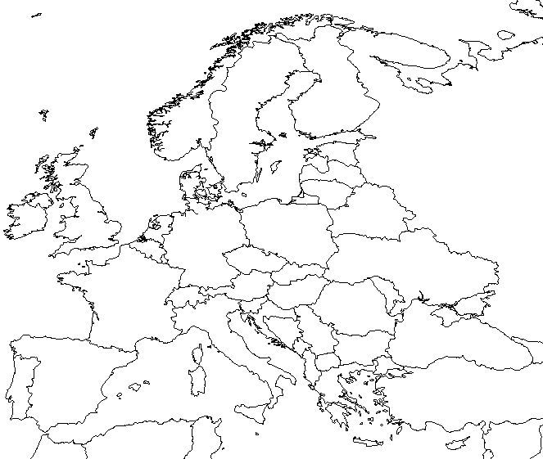
Distribution Network Configurations for Containerized Import Cargo (Retail) in Europe
Distribution based on RDCs
Distribution based on one EDC
Distribution based on tiered system (EDC+RDCs)
Distribution based on local DCs
Notes:
Source: adapted from Rodrigue, J-P and T. Notteboom (2010) "Comparative North American and European Gateway Logistics: The Regionalism of Freight Distribution", in press, Journal of Transport Geography.

Slide 162
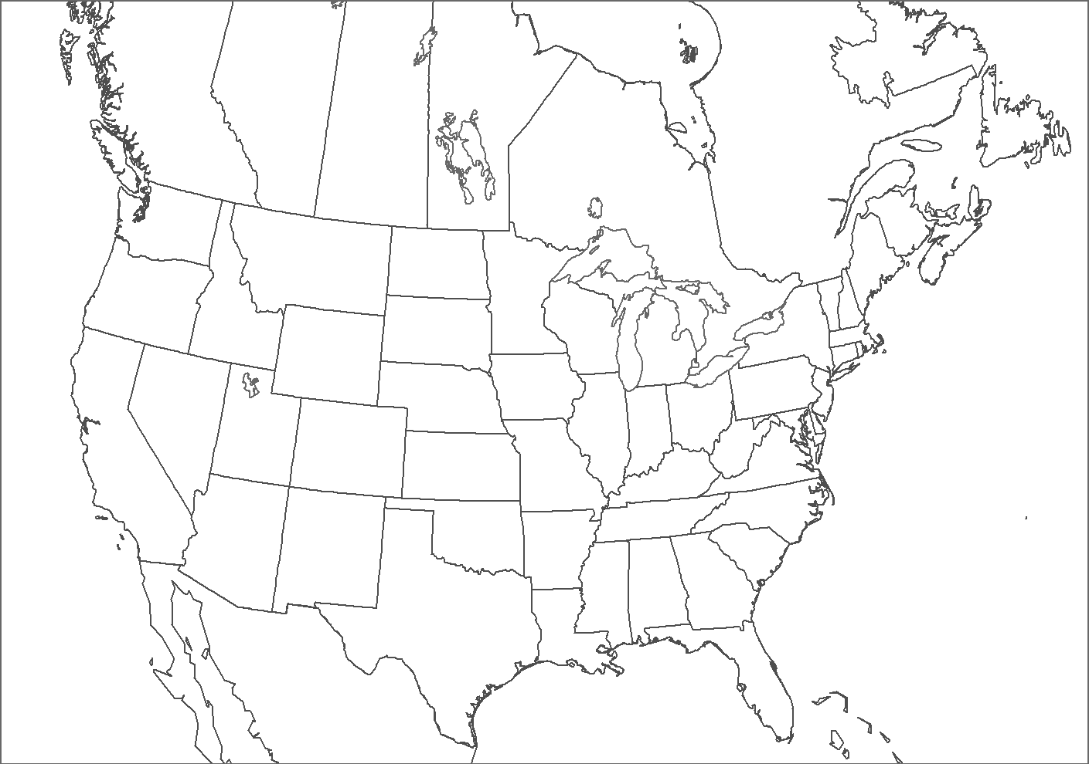
Distribution Network Configurations for Containerized Import Cargo (Retail) in North America
Distribution based on RDCs
Distribution based on two gateways
Distribution based on tiered system
Distribution based on local DCs
Notes:
Source: adapted from Rodrigue, J-P and T. Notteboom (2010) "Comparative North American and European Gateway Logistics: The Regionalism of Freight Distribution", Journal of Transport Geography, Vol. 18, No. 4, pp. 497-507.

Slide 163
Basic Operational Characteristics by Number of Warehouses, United States and China, 2009
Notes:
Source: Chicago Consulting (2009) The 10 Best Warehouse Networks, http://www.chicago-consulting.com/10best.shtml

Slide 164
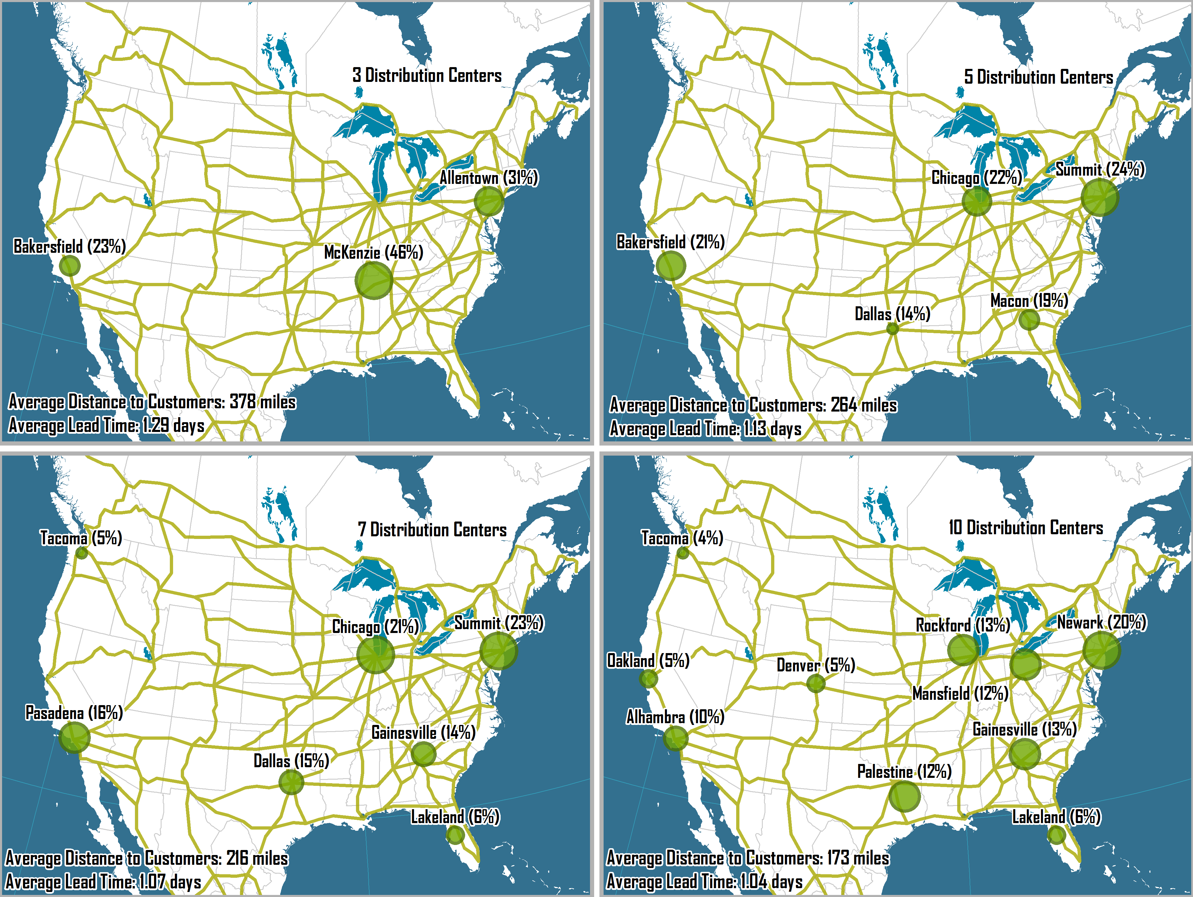
Optimal Location and Throughput by Number of Freight Distribution Centers
Notes:
Source: Adapted from Chicago Consulting. http://www.chicago-consulting.com/10best.shtml

Slide 165
Market Area of Distribution Centers Located in the United States, 2012
Notes:
Source: adapted from Supply Chain Group’s 2012 Warehouse and Distribution Center (DC) Operations Survey, Peerless Research Group.

Slide 166
Hours of Operation of Distribution Centers
Notes:
Source: Washington Warehouse/Distribution Center Industry: Operations & Transportation Usage, Washington State University, 2004
Note: Number of facilities open at specific hours.

Slide 167
A Typology of Spatial Dynamics in the Location of Logistics Sites
SPATIAL PROCESS
Spatial concentration of logistics sites
Spatial diffusion of logistics sites
Zoning
Dezoning
Logistics zones
SPATIAL LEVEL
Polarisation
Depolarisation
Logistics poles
Multimodal transshipment centre (e.g. Container terminal)
Logistics site (single or multi-user)

Slide 168
Proximity and Intermediacy for Distribution Clusters
Long distance transport corridor
Central business district
Sub center
Central area
Logistics cluster
Metropolitan area
Mega region
Intermediacy link
Urban Corridor
Proximity link

Slide 169
Cross-Docking Distribution Center
Distribution Center
Before Cross-Docking
Suppliers
Suppliers
LTL
Receiving
Customers
Sorting
After Cross-Docking
Shipping
FTL
Cross-Docking DC
FTL
Customers

Slide 170
Freight Distribution and Network Strategies
Point-to-Point
Fixed Routing
B
B
A
A
Corridor
Flexible Routing
B
B
A
A
Hub-and-Spoke
B
Transshipment node
Route node
Route
Network node
Alternative route
A
Unserviced node
Notes:
Source: Adapted from WOXENIUS, J. (2002) Conceptual Modelling of an Intermodal Express Transport System, International Congress on Freight Transport Automation and Multimodality: Delft, The Netherlands.

Slide 171
Logistics Networks
Network Structure
Point to Point
Hub-and-spoke
Dispersed
Locations
Clustered

Slide 172
Collaborative Distribution
Back-Haul Matching
Sequence Matching
A
C
Before
D
Empty
B
After
Supplier
Customer

Slide 173
Logistical Strategies to Cope with Higher Transport Costs
Shipping less | Demand responsive systems. Reduce returns.
Shipping timing | Allow longer shipping time and outside rush (high cost) periods.
Efficient packaging | Reduce the shipment size (volume) of the same load.
Modal shift | Use a mode that is less impacted by congestion.

Slide 174
Complexity of the Supply Chain
Simple
Complex
National Supply Chain
Multinational Supply Chain
National
International
Factory
Distribution center
Representative
High-throughput DC

Slide 175
20 Largest North American Warehouse Operators, 2007
Notes:
Source: Modern Materials Handling, http://www.mmh.com/article/356188-Warehouse_giants_The_largest_3PL_and_public_refrigerated_warehouses_of_2007.php

Slide 176
The Evolution of Retail Logistics
Suppliers / Wholesalers
Stores
1970s
Direct
replenishment
1980s
Rationalization
Distribution Centers
Import Centers
1990s
Overseas suppliers
Global sourcing
Domestic suppliers
Distribution Centers
Parcel hubs
Parcel delivery centers
Customer home
2000s
Digitalization
Sortation centers
Collection point
E-fulfillment centers
Local depots
Delivery point
Notes:
Source: Adapted from: Jones Lang Lassalle (2013) E-commerce boom triggers transformation in retail logistics: Driving a global wave of demand for new logistics facilities.
http://www.jll.com/Research/eCommerce_boom_triggers_transformation_in_retail_logistics_whitepaper_Nov2013.pdf

Slide 177
The Evolution of Retail Logistics
Procurement
Distribution
Global
National / Regional
Metropolitan Area
Urban Core
1980s
Suppliers / Wholesalers
Rationalization
Distribution Centers
Stores
Regional supply chains, Warehousing districts
Suburbanization, Shopping malls and superstores
1990s
Overseas suppliers
Global sourcing
Import Centers
Global supply chains, Logistics sprawl
Suburbanization, Shopping malls and megastores
Parcel hubs
Parcel delivery centers
Customer home
2000s
Sortation centers
Local depots
Collection point
Digitalization
E-fulfillment centers
Delivery point
Global supply chains, Logistics sprawl
City logistics and fast deliveries

Slide 178
The Impacts of E-commerce on Freight Distribution
1
2
Distribution Pattern
Real Estate Footprint
Distributional consumption.
Growth in B2C deliveries.
Changes in last mile logistics.
Shift of the real estate footprint from retail to distribution.
Changes in locational dynamics.
3
4
Logistical Facilities
Vertical Integration
New logistical facilities (E-fulfillment, Sortation center, Urban logistics depot).
Automation of fulfilment and inventory management.
Development of 3PL and 4PL services.
Dedicated carrier services (truck, air, non-vessel operating common carrier).

Slide 179
Logistics Facilities Supporting E-commerce
Facility Type | Facility Attributes | Locational Attributes
E-Fulfillment Center | Large-sized facility (half a million to one million square foot). Cross-docking configuration common. High racks storage. Push towards automation. | Low land costs. Proximity to highway. Access to a major parcel hub.
Parcel Hub / Sortation Center | Large-sized facility (half a million square foot). Cross-docking configuration for handling trucks. Automated and semi-automated sortation. | Low land costs. Accessibility to regional distribution.
Parcel Delivery Center / Urban Logistics Depot | Medium-sized facility. Cross-docking configuration for loading vans. | Periphery of metropolitan areas.
Freight Station / Pickup Location | Small or micro-sized facility. Store-like facility (pickup location). Locker banks (freight station). | High density neighborhood locations.
Notes:
Source: Adapted from: Jones Lang Lassalle (2013) E-commerce boom triggers transformation in retail logistics: Driving a global wave of demand for new logistics facilities.

Slide 180

Logistics Facilities Supporting E-commerce
Inbound Cross Dock
E-Fulfillment Center
Large-sized.
Receiving containers and holding inventory.
Double side cross-docking configuration.
Close to intermodal terminals.
Large-sized.
Single side cross-docking configuration common.
High racks automated storage.
Item specialization.
Access to a major parcel hub.
Sortation Center
Delivery Station
Large-sized.
Cross-docking configuration for loading trucks.
Automated and semi-automated sortation.
Accessibility to regional distribution.
Medium to small-sized.
Cross-docking configuration for loading delivery vehicles.
Periphery of metropolitan areas.
Local Freight Station
Fast Delivery Hub
Small or micro-sized.
Store-like facility (pickup location).
Locker banks (freight station).
High density neighborhood locations.
Small to medium-sized.
Near large metropolitan areas.
Limited inventory of high demand items.
Some co-location with e-fulfillment centers.
Notes:
Source: Adapted from: Jones Lang Lassalle (2013) E-commerce boom triggers transformation in retail logistics: Driving a global wave of demand for new logistics facilities.

Slide 181
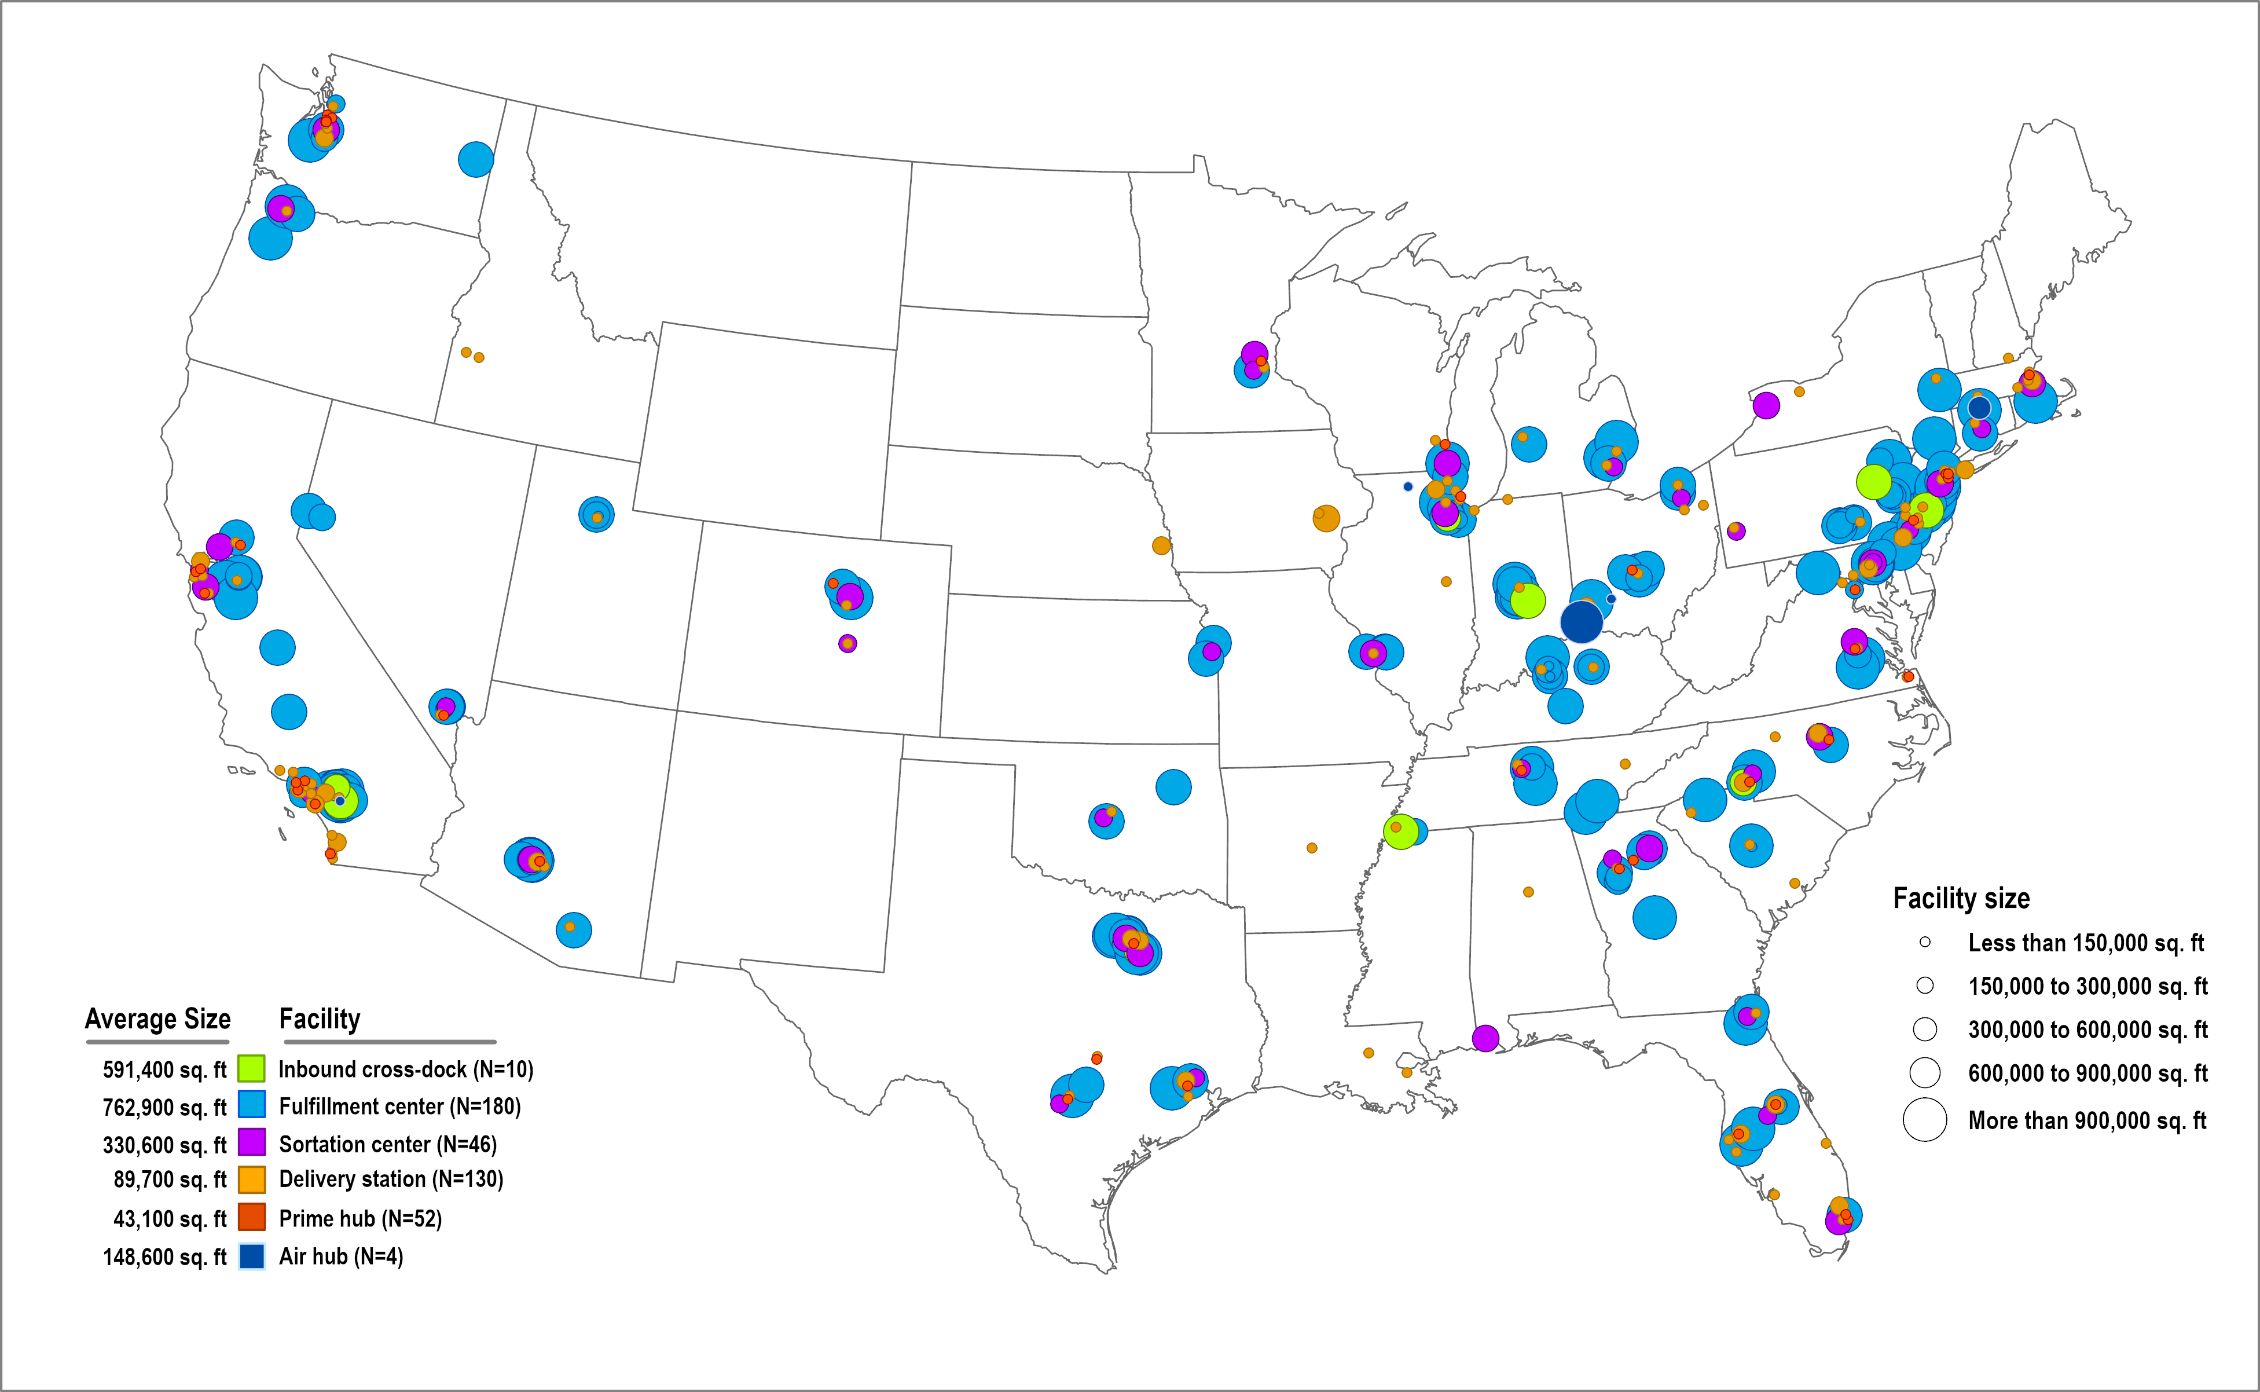
E-Commerce Facilities Operated by Amazon in the United States, 2019
Notes:
Source: MWPVL International. http://www.mwpvl.com/html/amazon_com.html

Slide 182
E-Commerce Facilities Operated by Amazon in the United States, 2018
Notes:
Source: MWPVL International. http://www.mwpvl.com/html/amazon_com.html

Slide 183
Retail Logistics and E-commerce
Conventional Retail Logistics
E-commerce Retail Logistics
Suppliers
Suppliers
Procurement
Regional
Distribution
Center
E-Retailer
Inventory Management (Backend)
RDC
Store Deliveries
RDC
RDC
Order Processing and Packaging (Frontend)
Retailer
(In store
inventory)
Order
Online
purchases
Parcel Delivery
Company
Home
Deliveries
Tracking
Deliveries (home, work or collection point)
Travel to
store
Customers
Customers
Notes:
UPS handles 9 million parcels per day created by e-commerce. Reduce costs, such as process and transaction. Could reduce the cost of making a car by 14%. Paradox of trimming of the supply chain. Complexity of distribution.

Slide 184
Comparison Between Retail and E-commerce Cost Structures for a $150 Apparel Piece
Notes:
Source: Adapted from the Wall Street Journal and Onestop Internet Inc.

Slide 185
Shifts of Logistical Operations in the Internet Economy
 | Traditional logistics | E-logistics
Orders | Predictable | Variable
Order cycle time | Weekly | Daily or hourly
Customer | Strategic | Broader base
Customer service | Reactive, rigid | Responsive, flexible
Replenishment | Scheduled | Real-time
Distribution model | Supply-driven (push) | Demand-driven (pull)
Demand | Stable, consistent | More cyclical
Shipment type | Bulk | Smaller lots
Destinations | Concentrated | More dispersion
Warehouse reconfiguration | Weekly or monthly | Continual, rule-based
International trade compliance | Manual | Automated
Notes:
Source: adapted from Thompson, R., Manrodt, K., Holcomb, M., Allen, G., and Hoffman, R. (2000) Logistics @ Internet speed: the impact of e-commerce on logistics. Ninth Annual Report on Trends and Issues in Logistics and Transportation, Knoxville (TN): Cap Gemini Ernst & Young and The University of Tennessee.

Slide 186

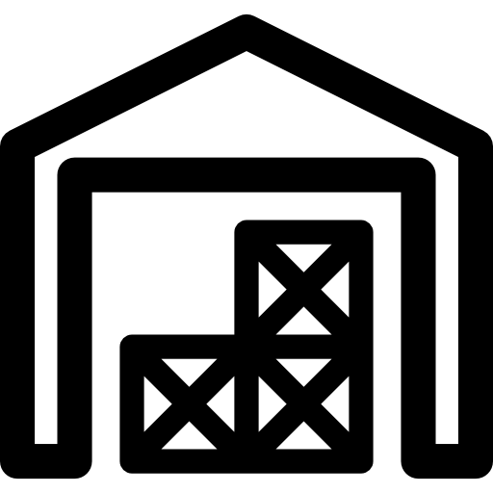
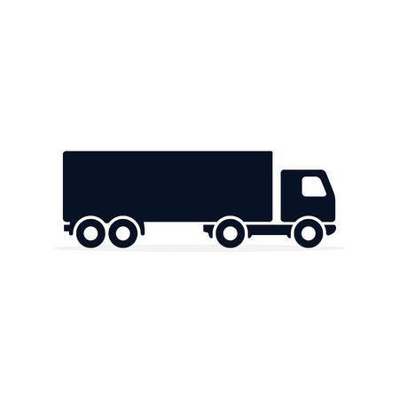

Elements of “Last Mile” Logistics
Terminal
Warehousing
Capacity; turnover; gate access
Inventory level; lead time; transloading
Drayage
Deliveries
Congestion; chassis management
Congestion; parking

Slide 187
The “Last Mile” in Inland Freight Distribution
Flow Chain
Frequency
Volume
Massification
Atomization
GLOBAL
HINTERLAND
REGIONAL
LOCAL
Shipping Network
Corridor
Drayage
LTL
Customer
Gateway
Inland Terminal
Distribution
Center
Transloading
Drayage
“Last Mile”
LTL
Customer
Transport Chain
GLOBAL
LOCAL
Maritime
Frequency
Rail / Barge
Volume
Drayage (Truck)
Less than truckload (LTL)
Gateway Logistics
“Last Mile”

Slide 188
Main Elements in Supply Chain Integration
Element | Purpose
Infrastructure Integration | Improving connectivity and interoperability. Synchronizing terminals and distribution facilities to increase throughput and reliability.
Commercial Integration | Commercial agreements, mergers and acquisitions between companies along the supply chain. Involves service level and management. Vertical and horizontal integration of actors and processes.
Work Practices Integration | Organizational (managing labor as a group) and skills (managing individual workers) competencies to move cargo efficiently. Involves operational window, minimal service levels and essential services.
Information Integration | Interconnectedness of information systems. Involves asset tracking, status monitoring, customs facilitation, freight status information and transport network status information.
Regulatory Integration | Promote modal choice and avoid subsidized modal preference through the harmonization of regulation across jurisdictions.
Planning and Funding Integration | Planning and funding of infrastructure provision from an integrated multi-modal and logistics chain perspective. Respective roles and competencies of the public and private sectors.
Customs and Security Integration | Harmonization of security procedures that protect cargo from theft or damage and protect the public from risks. Involves assessments of cargo contents, cargo integrity, route integrity and information integrity.

Slide 189
Main Elements in Supply Chain Integration and Connectivity
Transport Connectivity
Improving connectivity and interoperability of modes and terminals (intermodalism).
Infrastructure and superstructure improvements (capacity and throughput).
Synchronizing terminals and hinterland flows to increase throughput and reliability.
Commercial Integration
Trade and commercial agreements. Mergers and acquisitions along the supply chain.
Cost, time and reliability of transport and distribution services.
Vertical and horizontal integration of actors and processes (e.g. bill of lading).
Customs and Security Integration
Moving cargo more efficiently across borders through prescreening and inspections.
Harmonization of customs and security procedures.
Assessments of cargo contents, cargo integrity, route integrity and information integrity.
Regulatory Integration
Promote modal choice and avoid subsidized modal preference.
Harmonization of regulations across jurisdictions such as for vehicles, goods handling and transport, land use, labor and finance. Promotion of standards and certification.

Slide 190
Main Elements in Supply Chain Integration and Connectivity
Planning and Funding Integration
Planning and funding of infrastructure provision from an integrated multi-modal and logistics chain perspective.
Respective roles and competencies of the public and private actors.
Work Practices Integration
Organizational (managing labor as a group) and skills (managing individual workers) competencies to move cargo efficiently.
Operational window (working hours), minimal service levels and essential services.
Automation of repetitive tasks.
Information Systems Integration
Interconnectivity of information systems with blockchains.
Asset tracking, status monitoring, customs facilitation, freight status information and transport network status information.

Slide 191
Supply Chains and Blockchains
Supplier
Carrier
Manufacturer
Carrier
Distributor
Carrier
Customer
Physical
Flows
Certificate of origin
Batch numbers
Assembly data
Order number
Shipment number
Equipment number
Shipment date
Order number
GTIN/SKU
Receive date
Storage location
Packaging
GTIN/SKU
Order number
Shipment number
Equipment number
Information
Flows
Receive date
Order number
Invoice number
Customer ID
Shipment date
Order number
GTIN/SKU
Certificate of origin
Batch numbers
Assembly data
Order number
Shipment number
Equipment number
Shipment date
Order number
GTIN/SKU
Blockchain
Smart Contracts
Match order, invoice, shipment
Quality check
Pay supplier
Match order, invoice, shipment
Quality check
Update inventory
Pay manufacturer
Match order, invoice, shipment
Update inventory
Pay distributor

Slide 192
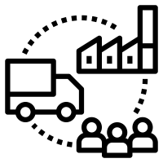



Expected Benefits of Blockchains on Supply Chains
Velocity of Supply Chains
Faster transactions.
Less latency, improving cash flow and inventory carrying costs.
Supply Chain Visibility (Tracking)
Track shipments along an intermodal transport chain and identify issues causing delays.
Create a market where service providers bid to handle “blocs”.
Supply Chain Security (Tracing)
See where, when and how a specific event took place (e.g. cold chain logistics).
Counterfeiting and the use of sub-par materials easier to detect.
Standards and Certification Compliance
Proof that cargo was handled by specific modes, carriers and distribution centers.
Calculate accurately energy use and environmental impacts (e.g. CO2 footprint) .

